Slide 1
Cybersecurity Threat Identification and Defense Methods
This work is licensed under CC BY-NC-SA 4.0.

Slide 2
Content
Common cyber threats: phishing, malware, ransomware.
Case studies and real-world examples.
Methods for identifying suspicious activities.
Creating and managing strong passwords.
Importance of two-factor authentication.
Tips for secure password usage

Slide 3
Common Cyber Threats

Slide 4
Malicious Software
Malicious software, also known as malware, malicious software, malicious code, or abbreviated as malcode, refers to programs or code snippets that are intentionally designed to perform harmful activities without the user's consent or knowledge.

Slide 5
Goals of Malicious Software
Data Theft and Trading
Theft of passwords, banking information, personal and sensitive data (e.g., keyloggers).
Stolen data may be used or sold on the black market.
System Damage
Disruption of system functionality.
Methods: file deletion, data corruption, complete system paralysis.
Illegal Activities
Spam distribution and use of infected systems for attacks.
System Disruption
Execution of Denial-of-Service (DoS) attacks.
Slowness, instability, and errors, making computer use difficult for the user.
Resource Exploitation
Hidden malware and cryptocurrency mining software.
Excessive CPU and memory usage, reducing computer performance and lifespan.
Data Traffic and Storage Usage
Consequences: excessive storage and data traffic consumption, leading to system performance degradation.

Slide 6
Types of Malicious Code - Viruses
Viruses are malicious programs that spread by attaching themselves to infected files.
Activation mechanism: the user opens or executes the infected file.
Spread and system damage:
Target system components.
Can corrupt or delete data.
May completely destroy systems.
A computer virus replicates itself and embeds itself into a program, becoming part of it.
Most viruses hide within executable files.
The infected host program may continue to function.
Some viruses are designed to destroy their host programs.

Slide 7
Types of Malicious Code - Worms
Worms operate independently and do not require user interaction to spread.
A worm is a standalone program that does not need a host file to propagate.
Example: The "ILOVEYOU" Worm (2000)
Within ten days, it reached 10% of all internet-connected computers.
Impacts:
Crashed servers and paralyzed corporate and government databases.
Infection method:
Users received an email with the subject "I LOVE YOU", containing an attachment: LOVE-LETTER-FOR-YOU.TXT.vbs.
The worm, written in VBScript, searched the infected computer's Outlook address book and immediately forwarded itself to all contacts.
It overwrote music and image files with binary garbage.
Ransomware has also spread using similar worm-based techniques.
Notes:
https://hvg.hu/tudomany/20100504_10_eves_az_iloveyou_virus Onel De Guzman középiskolai érettségi dolgozatának részeként írta

Slide 8
Types of Malicious Code - Trojans
Named after the Trojan Horse from Greek mythology, these malicious programs use deception to infiltrate a system. They disguise themselves as harmless or useful applications while secretly performing harmful activities.
Types of Trojans
Backdoor Trojan:
Attackers gain unauthorized access to the infected computer and can remotely control it.
Purpose:
Transfer files to the compromised system.
Execute files and commands on the infected device.
RAT (Remote Access Tool)
A type of backdoor Trojan that allows remote control over the victim’s system, often used for spying or executing commands.
Spyware (Keylogging & Monitoring Software):
Tracks user activity, including passwords and browsing history.
Often used to steal sensitive information without the user’s knowledge.
Notes:
Görög mítosz

Slide 9
Types of Malicious Code - Bots
The term bot originates from the word robot and refers to automated processes.
Bots are malicious software programs that turn an infected system into a bot, allowing it to execute remote commands.
Infected computers often become part of a larger network of compromised devices called a botnet.
Botnets are commonly used for:
Distributed Denial-of-Service (DDoS) attacks
Spam distribution
Other cybercriminal activities
Bots operate autonomously and silently, often without the user’s knowledge, and remain accessible to attackers for executing commands remotely.

Slide 10
The Growing Impact of Cybercrime
71.1 million people fall victim to cybercrime every year.
The number of cyberattacks increases by 15% annually.
Every 40 seconds, a business is attacked by ransomware somewhere in the world.
The estimated global financial loss due to cybercrime is $318 billion per year (equivalent to 9.5 million years of wages).
These figures are expected to rise further due to advancements in artificial intelligence (AI).
source: https://hu.euronews.com/2024/05/08/evente-15-al-no-a-kiberbunozok-altal-okozott-kar-vilagszerte

Slide 11
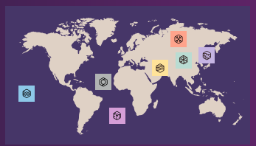
Distribution of Damages
Source: Microsoft Digital Defense Report 2024
Cryptocurrency theft Cybercriminal services Data destruction Data theft for financial gain Disruption/Sabotage Election interference Espionage Influence operations Ransomware/Extortion

Slide 12
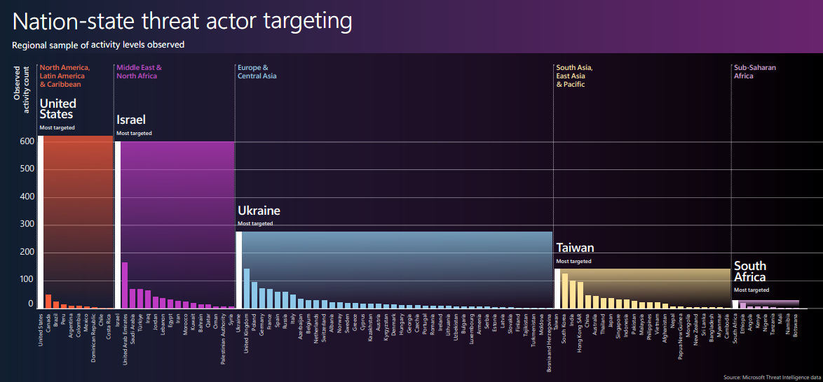
Distribution of Damages

Slide 13
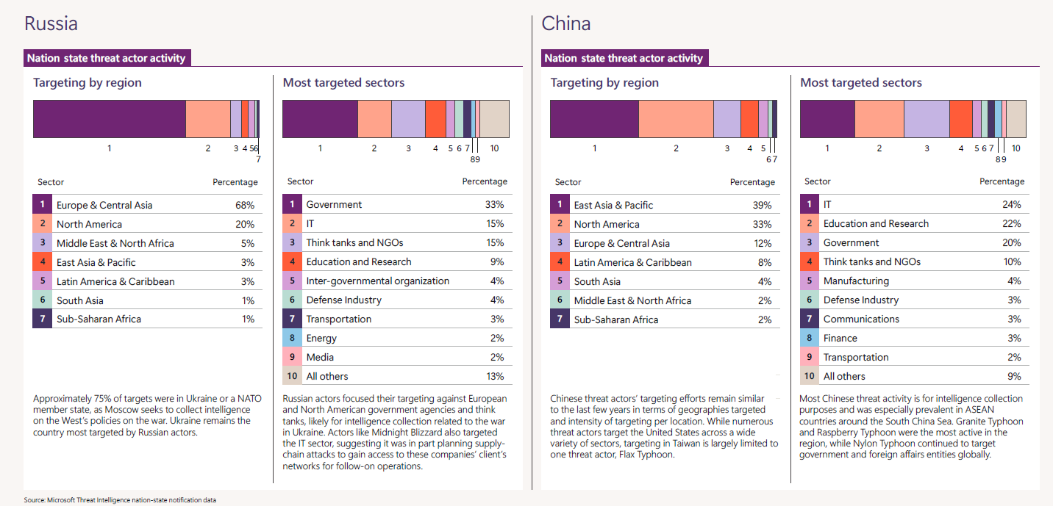
The Targets

Slide 14
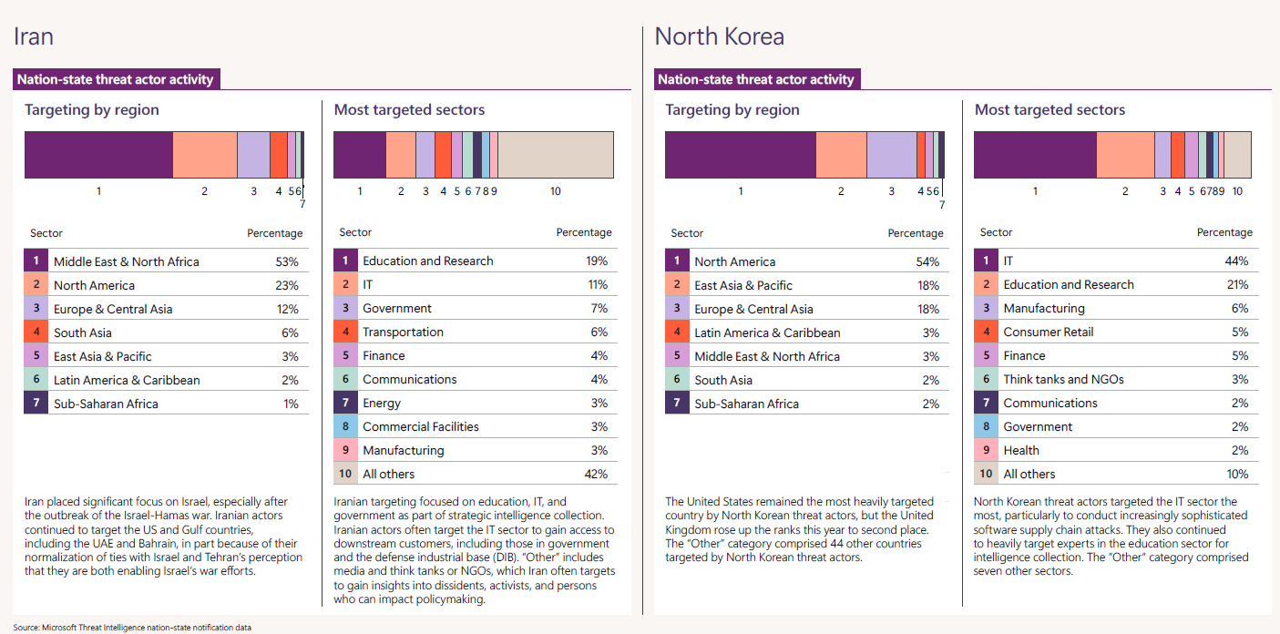
The Targets

Slide 15
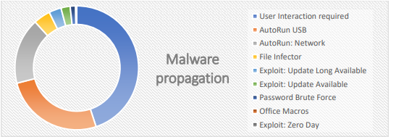
Propagation of Malicious Code

Slide 16
Methods for Identifying Suspicious Activities

Slide 17
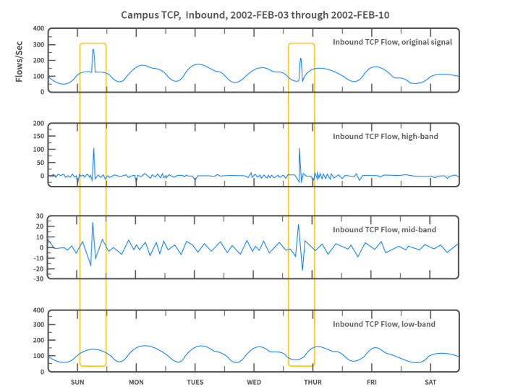
Main Types of Suspicious Activities
Network anomalies (e.g., sudden increase in traffic)
Unusual user behaviour (e.g., an employee logging in at night from a foreign IP)
Data theft attempts (e.g., unauthorized access)
Malware and exploit attacks
Source: https://www.progress.com/blogs/science-of-network-anomalies

Slide 18
Methods for Detecting Suspicious Activities
Heuristic analysis – Based on predefined rules and patterns
Artificial intelligence and machine learning – Capable of detecting previously unknown attack patterns
Behavior-based detection – Monitoring deviations from normal user behavior
SIEM systems (Security Information and Event Management) – Security information and event management tools

Slide 19
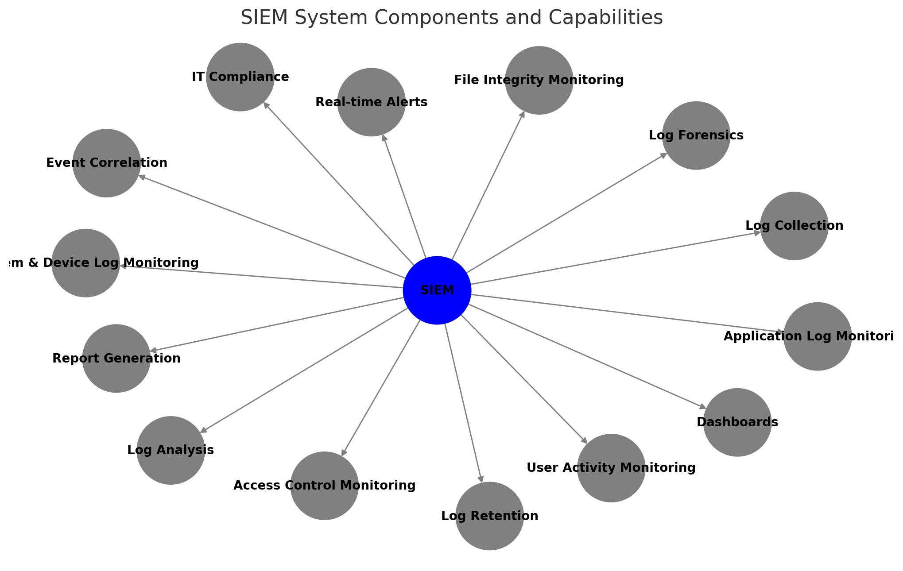
SIEM Systems
SIEM tools collect, aggregate, and analyze vast amounts of data from an organization's applications, devices, servers, and users in real-time, enabling security teams to detect and block attacks.
Log Management: The system gathers large volumes of data in one place, organizes it, and determines whether there are indicators of threats, attacks, or security incidents.
Event Correlation: The system processes and organizes data to identify relationships and patterns, allowing for rapid detection and response to potential threats.
Incident Monitoring and Mitigation: The technology continuously monitors security incidents within the organization's network, sends alerts, and conducts audits of all activities related to incidents.
https://nki.gov.hu/it-biztonsag/elemzesek/a-siem-rendszerek-mukodese/

Slide 20
Passwords

Slide 21
Why Strong Passwords Are Important
Weak passwords can be cracked by hackers in seconds.
The 10 most common passwords can be broken in less than a second, whereas complex passwords may theoretically take hundreds or even thousands of years to crack.
In 2022, cybercriminals had access to 24 billion username and password combinations.
In the event of a password leakage, compromised passwords can grant access to additional accounts. Source: MTI 2023.06.17 https://hirado.hu/extra/tudomany-high-tech/cikk/2023/06/17/felelmetes-statisztika-tobb-mint-20-milliard-felhasznalonev-es-jelszokombinacio-van-a-kiberbunozok-kezeben

Slide 22
Most Commonly Used Passwords
123456
123456789
12345678
password
qwerty123
qwerty1
111111
12345
secret
123123

Slide 23
Weak passwords
Contains personal information (e.g., name, birthdate).
Too short (typically less than 8 characters).
Sequential characters.
The same password is used in multiple places.
Contains only letters or numbers.

Slide 24
Risks of Weak Passwords 1
Unauthorized Access
Hacking a personal social media account or gaining entry into a confidential corporate database.
An attacker can steal sensitive data, impersonate the victim, or disrupt operations.
Account Takeover
If attackers gain access to one account, they can use the information found there to compromise other accounts, especially if the same password is reused.
This can create a domino effect, leading to widespread data loss.
Data Breach
A single weak password can result in an entire database being compromised.
Attackers can use one breached account to infiltrate an entire network, including personal and business data.
Identity Theft
With a compromised password, attackers can impersonate the victim.
They may apply for loans or carry out fraudulent activities in the victim's name.

Slide 25
Risks of Weak Passwords 2
Financial Losses
Weak passwords can lead to direct financial losses.
A compromised business account may result in the theft of intellectual property, money, or customer data.
For individuals, losing banking or credit card information can cause significant financial damage.
Loss of Website Control
For website administrators, weak passwords pose a serious risk.
Attackers can take over the site, modify content, steal customer data, or redirect visitors to malicious websites.
Reputation Damage
The impact of weak passwords extends beyond financial losses.
A security breach can lead to a loss of customer trust, causing long-term damage to a company’s brand.
Legal Consequences
Data breaches can have legal repercussions.
Affected individuals may take legal action, and companies may face severe fines for failing to protect sensitive data.

Slide 26
Common Password Cracking Techniques
Brute Force Attacks
A brute force attack is a trial-and-error method where attackers systematically try every possible password combination.
While time-consuming, it is effective against weak, short, and simple passwords.
Attackers use bots and automated tools to speed up the process.
Dictionary Attacks
Dictionary attacks use a pre-compiled list of likely passwords.
Instead of testing all possible combinations, attackers focus on commonly used words and phrases.
Rainbow Table Attacks
A rainbow table is a pre-generated lookup table that helps decrypt password hashes.
Attackers use these tables to quickly compare user password hashes with known values in the table.

Slide 27
Common Password Cracking Techniques
Credential stealing
Automated attacks where attackers use stolen usernames and passwords.
This is especially dangerous if someone reuses the same password across multiple accounts.
Social Engineering
Attackers use psychological manipulation to trick people into revealing confidential information.
Examples: Phishing, where the attacker impersonates a trusted person or organization.
Password Spraying
Attackers attempt a small set of commonly used passwords across many user accounts.
Unlike brute force attacks, they do not target a single account with thousands of passwords but instead test a few passwords across multiple accounts.

Slide 28
Safe Password Management
Do not write it down on paper or in digital notes.
Use a password manager
Do not share it with anyone.
Avoid patterns and dictionary words.
Do not reuse the same password across multiple accounts.
Use passphrases.
Enable two-factor authentication (2FA).

Slide 29
How to Create Strong Passwords
Tekintsük át a használt jelszavakat
Legalább 12-16 karakter hosszú legyen.
Használjon kis- és nagybetűket, számokat, különleges karaktereket (!@#$%^&*).
Ne legyenek szavak vagy könnyen kitalálható minták (pl. "1234").
Egyedi legyen minden fiókhoz.
Frissítsük gyakran a jelszavakat

Slide 30
2 Factor Authentication

Slide 31
Multi-Factor Authentication
What is Multi-Factor Authentication (MFA)?
It verifies a user's identity using multiple independent factors.
It significantly enhances security compared to simple password-based authentication.
Types of Authentication Factors:
Knowledge-based: Something you know (e.g., password, PIN code).
Possession-based: Something you have (e.g., mobile phone, hardware token).
Biometric: Something you are (e.g., fingerprint, facial recognition).
Always enable it whenever available!

Slide 32
Advantages / Challenges of Multi-Factor Authentication
Advantages
Protection against phishing and unauthorized access.
Reduces the likelihood of successful attacks.
Helps comply with security regulations (GDPR, PSD2).
Challenges
User resistance (inconvenience).
Technical issues (lost devices, system malfunctions).
Vulnerabilities of SMS-based MFA (SIM swap attacks).

Slide 33
Examples of MFA Usage
Ügyfélkapu
Internet banking
E-mail services (pl. Gmail, Outlook)
VPN, Remote desktop
Social media accounts

Slide 34
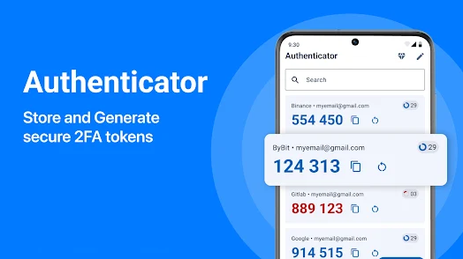
MFA implementations
SMS-based authentication
Mobile applications (Authenticator, Authy)
Hardware tokens (YubiKey)
Biometric solutions (e.g., Face ID, fingerprint scanners)

Slide 35
Coding task
Implement a simple signature-based virus scanner that scans files in a specified directory and detects whether they contain known malicious signatures. The program should:
Read a list of virus signatures from a predefined file (signatures.txt), where each line contains a known malicious pattern.
Scan all files in a given directory for these signatures.
Report infected files, showing the filename and the matched signature.
Provide a summary of the total number of scanned files and detected infections.

Slide 36
Requirements
Use any programming language for implementation.
The code should accept the directory path as a command-line argument.
The signature file (signatures.txt) should contain simple hexadecimal or ASCII patterns that represent known malware.
The program should read each file in binary mode to search for signatures.
Implement basic exception handling (e.g., handling permission errors, missing files).
Example signature file
E8 3F 00 00 00 59 85 C0 75
4D 5A 90 00 03 00 00 00
Expected output
Scanning directory: /path/to/directory
[INFECTED] file1.exe - Matched signature: 4D 5A 90 00 03 00 00 00
[INFECTED] file2.dll - Matched signature: E8 3F 00 00 00 59 85 C0 75
Scan complete: 10 files scanned, 2 infections found.

