Slide 1


Introduction to Cloud Computing and Azure
Fundamentals and benefits of cloud technology platforms
Notes:
AI-generated content may be incorrect. ---

Slide 2
Lecture 1 – Cloud Computing Foundations
Notes:
Course Context & Today’s Objectives, What Is Cloud Computing?, NIST Definition of Cloud Computing, Traditional IT vs Cloud, Evolution of Computing, Service Model Overview, Infrastructure as a Service, IaaS Architecture Layering, Platform as a Service, PaaS Benefits, Software as a Service, Responsibility Comparison Matrix, Deployment Model Overview, Public Cloud, Private Cloud, Hybrid Cloud, Multi-Cloud, Security Changes in the Cloud, Shared Responsibility Model, Responsibility in IaaS, Responsibility in PaaS, Identity as the New Perimeter, What Is Azure?, Azure Global Infrastructure, Core Azure Service Categories, Azure Compute Services, Azure Storage Services, Azure Database Services, Azure Networking Basics, Azure Identity, Azure DevOps and CI/CD, Typical Cloud Application Architecture, Cost Model in the Cloud, Cloud Advantages, Cloud Challenges, What Changes for Developers?, Cloud-Native Mindset, Key Takeaways, Next Lecture Preview

Slide 3
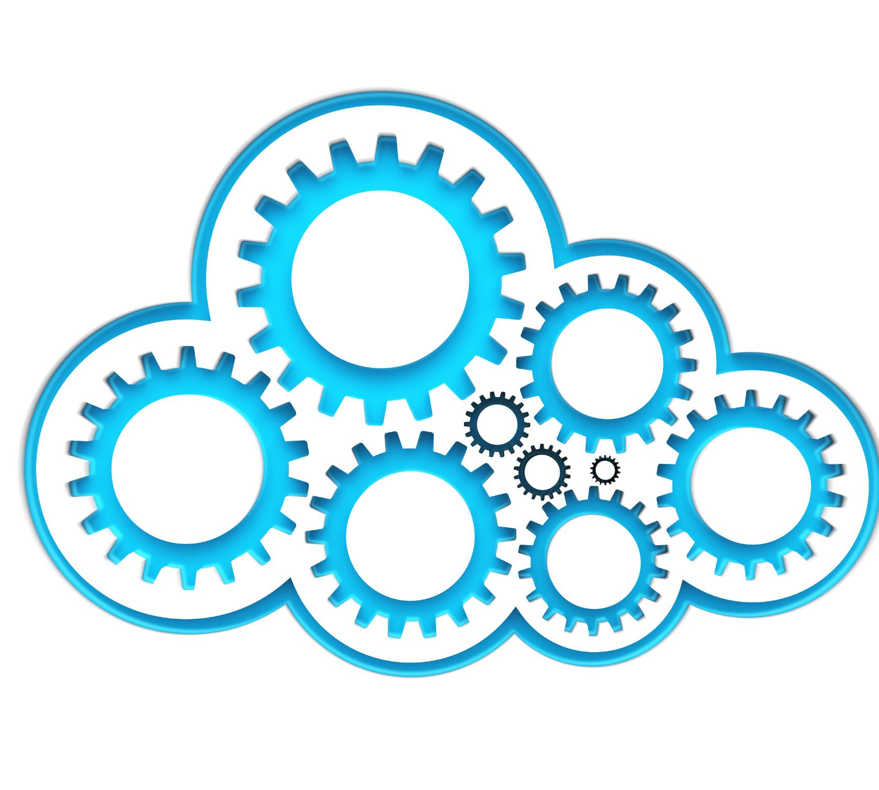
Course Context & Today’s Objectives
Course Scope and Focus
The course covers designing, building, deploying, and operating cloud-optimized applications beyond traditional data centers.
Foundational Cloud Concepts
Students learn core concepts essential for understanding cloud-native systems and architectures.
Key Learning Objectives
Objectives include cloud computing definitions, service models, deployment models, shared responsibility, and Azure platform overview.
Notes:
This slide introduces the Development of Cloud Applications course, defining its scope within modern software engineering. It clarifies that the course focuses on designing, building, deploying, and operating applications that are optimized for cloud environments rather than traditional data centers. The lecture establishes foundational cloud concepts that are critical for understanding cloud-native systems. Students are introduced to the key learning goals of the session, including understanding cloud computing definitions, service and deployment models, the shared responsibility model, and Azure as a real-world cloud platform. These objectives help frame the rest of the lecture and prepare students for deeper architectural discussions in subsequent lessons.

Slide 4
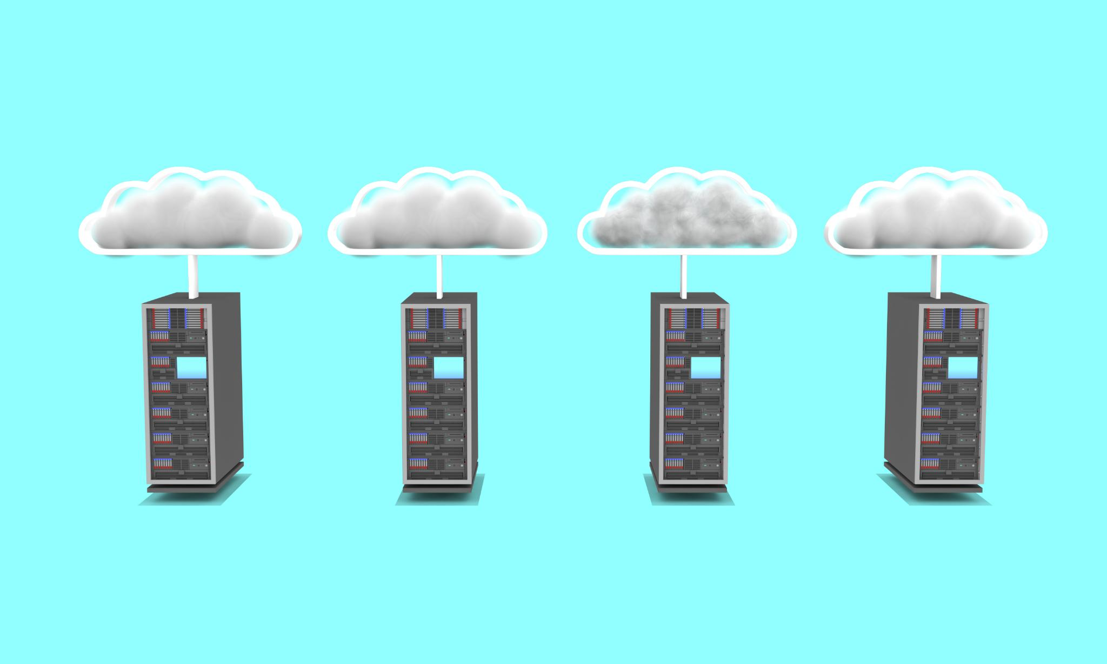
What Is Cloud Computing?
On-Demand Resource Delivery
Cloud computing delivers servers, storage, and networking instantly via APIs or portals without manual setup.
Elasticity and Scalability
Cloud platforms adjust resources dynamically to meet changing demands, supporting growth and flexibility.
Consumption-Based Pricing
Users pay only for the resources they consume, improving cost efficiency compared to traditional hosting.
Internet-Based Service Delivery
Cloud services are delivered over the internet, enabling global access and rapid innovation.
Notes:
This section explains cloud computing as an on-demand delivery model for computing resources such as servers, storage, and networking. It emphasizes instant provisioning through APIs or portals and contrasts this with manual infrastructure deployment. The slide highlights internet-based service delivery, elasticity, scalability, and consumption-based pricing. These characteristics collectively distinguish cloud systems from traditional hosting environments. Understanding these attributes helps students recognize why cloud platforms enable rapid innovation, global scalability, and cost efficiency for modern applications.

Slide 5
NIST Definition of Cloud Computing
On-demand Self-service
Users can provision computing resources automatically without requiring human interaction with service providers.
Broad Network Access
Cloud services are accessible over the network through standard mechanisms from diverse client platforms.
Resource Pooling
Computing resources are pooled to serve multiple consumers dynamically based on demand.
Rapid Elasticity
Capabilities can be elastically scaled rapidly to meet demand, appearing unlimited to users.
Measured Service
Cloud systems automatically control and optimize resource usage through metering and monitoring.
Notes:
Here the lecture presents the formal NIST definition of cloud computing, breaking it into five essential characteristics: on-demand self-service, broad network access, resource pooling, rapid elasticity, and measured service. These criteria provide a vendor-neutral way to define cloud systems and are often referenced in academic, regulatory, and enterprise standards. Understanding this model helps students align theoretical concepts with real-world implementations across all major cloud providers.

Slide 6
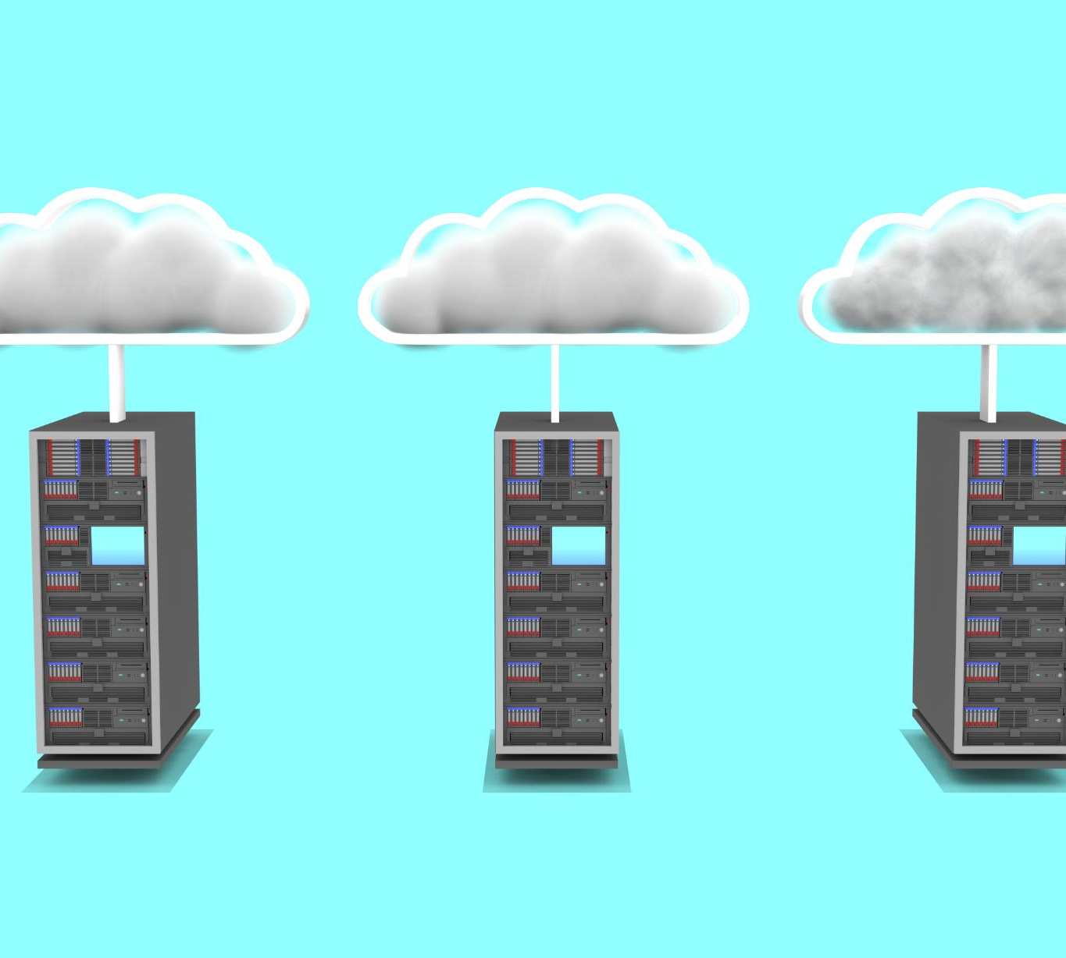
Traditional IT vs Cloud
Traditional IT Characteristics
Traditional IT demands upfront hardware costs, lengthy procurement, and manual system provisioning processes.
Cloud Model Benefits
Cloud models feature API-driven automation, rapid deployment, and usage-based billing for flexibility.
Reasons for Cloud Migration
Organizations move to cloud platforms to gain agility, speed, and optimize costs effectively.
Notes:
This comparison highlights the shift from capital-intensive traditional IT models to operational-expenditure-based cloud models. Traditional IT requires upfront hardware investment, long procurement cycles, and manual provisioning. In contrast, cloud environments offer API-driven automation, near-instant deployment, and usage-based billing. This contrast reinforces why organizations migrate to cloud platforms for agility, speed, and cost optimization.

Slide 7

Evolution of Computing
Centralized Mainframes
Early computing used centralized mainframes that managed all processing, limiting flexibility and scalability.
Client-Server Systems
Client-server architecture introduced distributed processing between clients and servers, improving resource use and access.
Virtualization and Cloud Computing
Virtualization abstracted hardware, enabling cloud computing with scalable, on-demand resources and automation.
Cloud-Native Architectures
Cloud-native architectures emphasize distributed design, elasticity, and resilience for modern scalable applications.
Notes:
The slide traces computing evolution from centralized mainframes through client-server systems, virtualization, cloud computing, and finally cloud-native architectures. Each step abstracts hardware details further and increases automation and scalability. Cloud-native systems represent the culmination of this evolution by embracing distributed design, elasticity, and resilience as first-class concerns.

Slide 8

Service Model Overview
Infrastructure as a Service (IaaS)
IaaS offers basic computing resources, giving customers control over infrastructure with minimal provider management.
Platform as a Service (PaaS)
PaaS provides a platform for application development, reducing management tasks and increasing provider involvement.
Software as a Service (SaaS)
SaaS delivers fully managed software applications, minimizing customer responsibility and maximizing provider control.
Notes:
This slide introduces Infrastructure as a Service, Platform as a Service, and Software as a Service. It explains how increasing abstraction reduces customer management responsibility while increasing provider involvement. Understanding these layers is essential for selecting appropriate cloud services based on control, flexibility, and operational complexity.

Slide 9

Infrastructure as a Service
Virtual Machines and Resources
IaaS offers virtual machines, networking, and storage resources that mimic traditional infrastructure with added flexibility.
Customer Control
Customers have full control over the operating system, managing patching, security, and application maintenance.
Use Cases
IaaS is ideal for lift-and-shift migrations and highly customized workloads requiring flexible infrastructure.
Notes:
IaaS provides virtual machines, networking, and storage while granting full operating system control to the customer. This model closely resembles traditional infrastructure but adds cloud flexibility. Customers manage OS patching, security configuration, and application maintenance, making IaaS suitable for lift-and-shift or highly customized workloads.

Slide 10
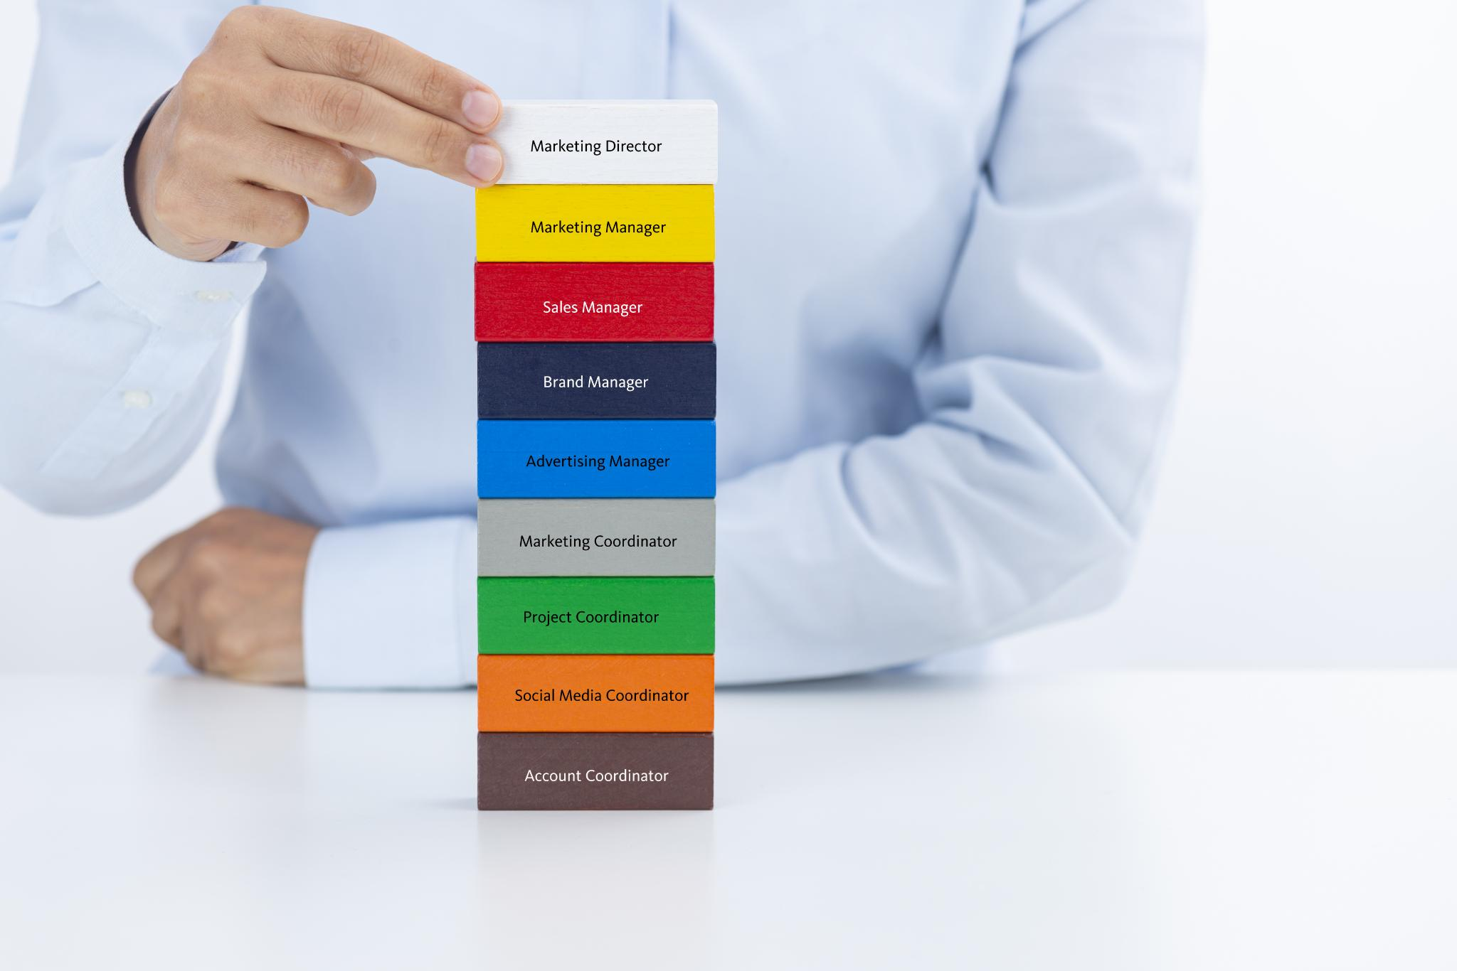
IaaS Architecture Layering
Customer Managed Layers
Customers are responsible for managing OS, middleware, runtime, data, and application layers in IaaS environments.
Provider Managed Layers
Providers manage physical hardware, networking infrastructure, and data center facilities ensuring reliable cloud service.
Shared Responsibility Model
The slide highlights the shared responsibility model to clarify duties between customers and providers in IaaS.
Notes:
This slide explains responsibility separation in IaaS. Customers manage the OS, middleware, runtime, data, and application layers, while the provider manages physical hardware, networking infrastructure, and data center facilities. The included stack diagram visually reinforces this division and prepares students for shared responsibility discussions.

Slide 11
Platform as a Service
Infrastructure Abstraction
PaaS removes the need to manage infrastructure and OS, letting developers focus on coding applications.
Built-in Scaling and Monitoring
Integrated scaling and monitoring features minimize operational overhead and optimize performance.
Accelerated Development
PaaS speeds up development cycles and reduces risks of configuration errors and security patches.
Notes:
PaaS abstracts infrastructure and operating system management, allowing developers to focus purely on application code. Built-in scaling, monitoring, and managed runtimes reduce operational overhead. This model accelerates development and reduces the risk of misconfiguration and unpatched systems.

Slide 12

PaaS Benefits
Faster Development Cycles
PaaS enables quicker application development by providing ready-to-use development tools and environments.
Reduced Operational Burdens
PaaS reduces infrastructure management complexity, allowing developers to focus on coding and innovation.
Automatic Scaling
PaaS platforms automatically scale resources to handle varying workloads efficiently without manual intervention.
Provider-Managed Security
Security patches and updates are managed by the service provider, ensuring systems stay secure and compliant.
Notes:
This slide highlights key PaaS advantages: faster development cycles, reduced operational burdens, automatic scaling, and provider-managed security patches. These benefits support rapid innovation and align with DevOps and continuous delivery principles.

Slide 13

Software as a Service
Managed Applications Delivery
SaaS provides fully managed applications accessible directly through web browsers without local installation.
Provider-Handled Maintenance
The service provider manages all infrastructure, platform, and application maintenance, ensuring seamless operation.
Subscription-Based Model
Organizations use SaaS on a subscription basis, eliminating operational responsibilities and upfront costs.
Notes:
SaaS delivers fully managed applications directly to users, typically via a browser. All infrastructure, platform, and application maintenance is handled by the provider. This model eliminates operational responsibility and enables organizations to consume software as a subscription-based service.

Slide 14
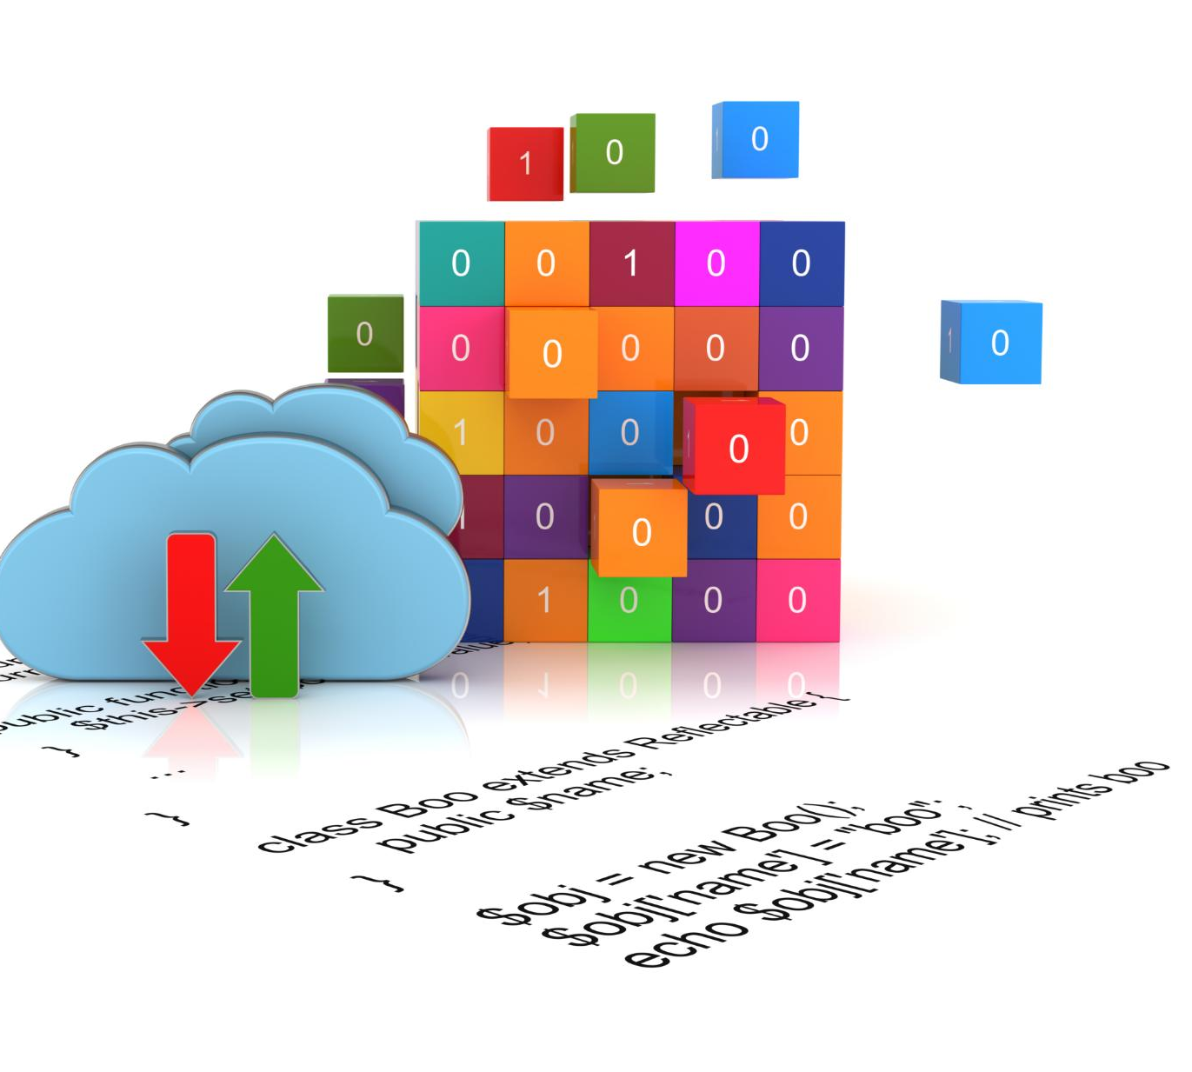
Responsibility Comparison Matrix
IaaS Responsibilities
In IaaS, users manage applications, runtime, OS, and middleware while providers handle networking and storage infrastructure.
PaaS Responsibilities
PaaS abstracts OS and runtime management, letting users focus primarily on application development and management.
SaaS Responsibilities
SaaS providers manage all infrastructure and software layers, minimizing user responsibility to only using the application.
Notes:
This slide introduces a conceptual matrix comparing networking, storage, OS, runtime, and application responsibilities across IaaS, PaaS, and SaaS. It prepares students to understand how responsibility shifts with abstraction level.

Slide 15
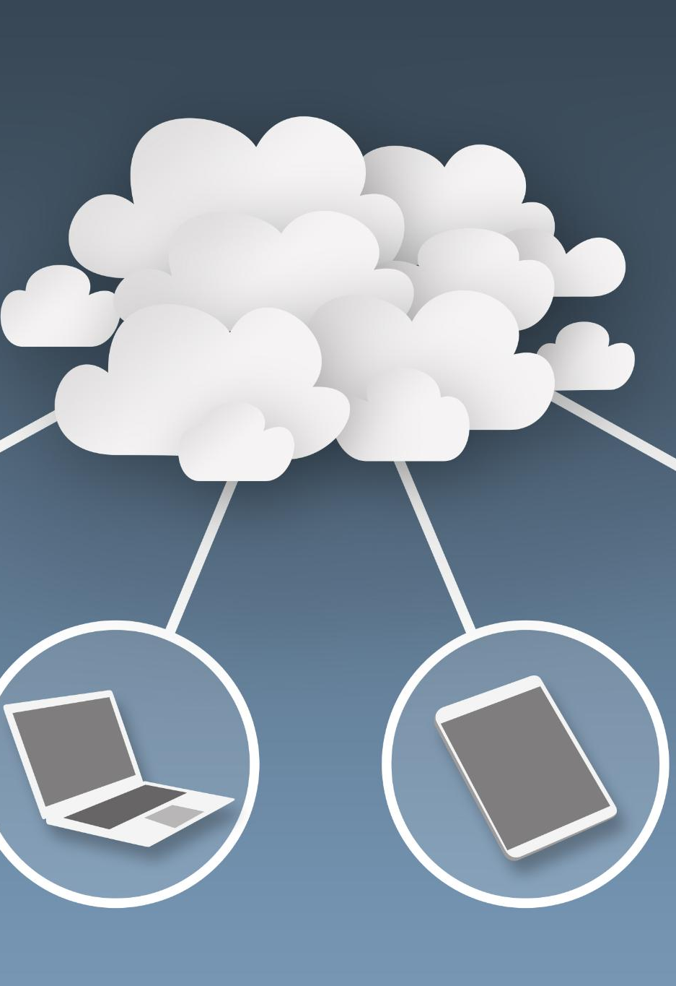
Deployment Model Overview
Public Cloud Model
Public cloud offers scalable resources managed by third-party providers with less control over infrastructure.
Private Cloud Model
Private cloud provides dedicated infrastructure controlled by a single organization ensuring higher compliance and security.
Hybrid Cloud Model
Hybrid cloud combines public and private clouds, balancing control, scalability, and flexibility for complex needs.
Multi-Cloud Model
Multi-cloud uses multiple cloud services across providers to optimize performance and avoid vendor lock-in.
Notes:
This section introduces public, private, hybrid, and multi-cloud deployment models. Each model reflects different trade-offs between control, scalability, compliance, and complexity.

Slide 16
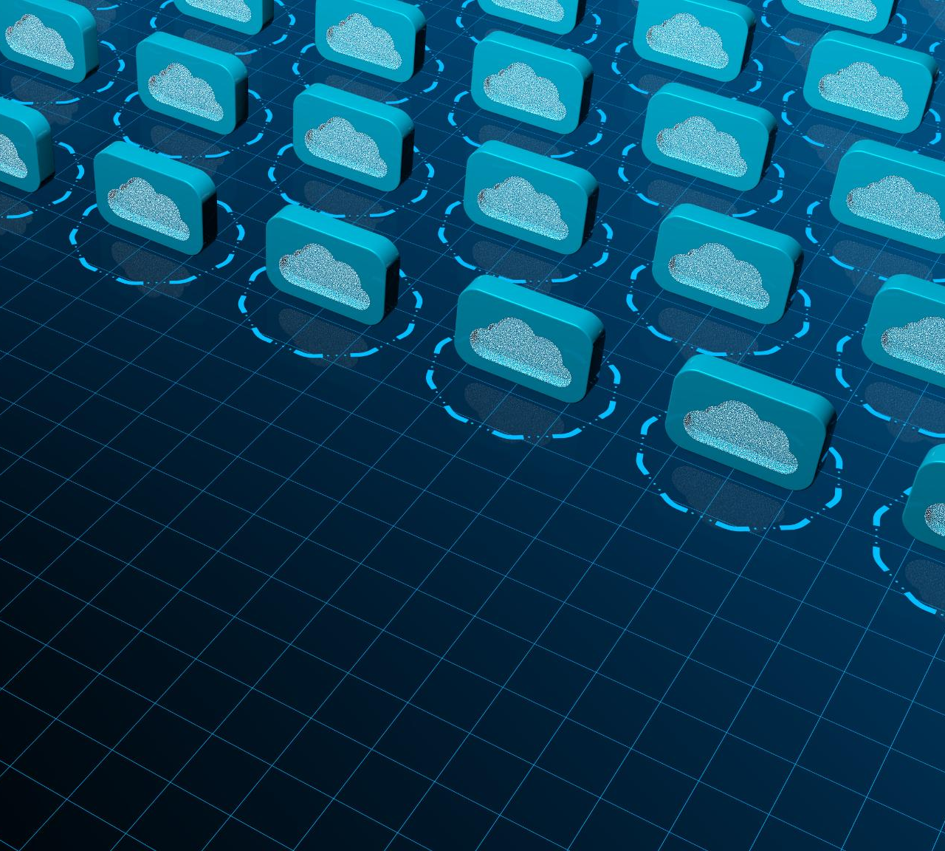
Public Cloud
Shared Multi-Tenant Infrastructure
Public clouds use shared infrastructure among multiple tenants to maximize resource utilization and reduce costs.
Logical Isolation for Security
Logical isolation techniques ensure data security despite shared infrastructure in public cloud environments.
Global Scalability and Expansion
Public clouds enable rapid scaling and regional expansion through globally distributed infrastructure.
Notes:
Public cloud environments use shared, multi-tenant infrastructure delivered at global scale. Logical isolation ensures security while enabling cost efficiency and rapid expansion across regions.

Slide 17

Private Cloud
Dedicated Infrastructure
Private cloud offers dedicated infrastructure, often hosted on-premise for exclusive use by one organization.
Higher Control and Customization
Organizations have greater control and customization capabilities with private cloud compared to public cloud options.
Regulatory Compliance Suitability
Private cloud is ideal for legacy systems and environments with strict regulatory or compliance requirements.
Reduced Elasticity
Private cloud offers less elasticity and scalability compared to public cloud services.
Notes:
Private cloud provides dedicated infrastructure, often on-premise, offering higher control and customization. It is suitable for legacy systems or strict regulatory requirements but has reduced elasticity compared to public cloud.

Slide 18

Hybrid Cloud
Integration of Systems
Hybrid cloud seamlessly integrates on-premise infrastructure with public cloud platforms using secure connections.
Gradual Migration
Hybrid cloud supports phased migration strategies allowing businesses to transition workloads progressively.
Workload Placement
Workloads are placed based on sensitivity and performance requirements to optimize operations in hybrid cloud.
Notes:
Hybrid cloud integrates on-premise systems with public cloud services using secure connectivity. It enables gradual migration strategies and supports workload placement based on sensitivity and performance needs.

Slide 19
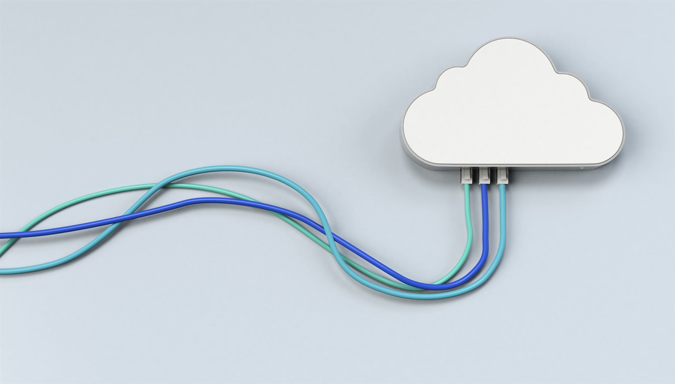
Multi-Cloud
Workload Distribution
Multi-cloud strategies spread workloads across several providers to avoid dependence on a single vendor.
Flexibility Advantage
Using multiple cloud providers offers greater flexibility to select optimal services for different needs.
Increased Complexity
Multi-cloud environments add architectural and operational complexity requiring careful management and integration.
Notes:
Multi-cloud strategies distribute workloads across multiple providers to reduce vendor lock-in. While offering flexibility, this approach increases architectural and operational complexity.

Slide 20
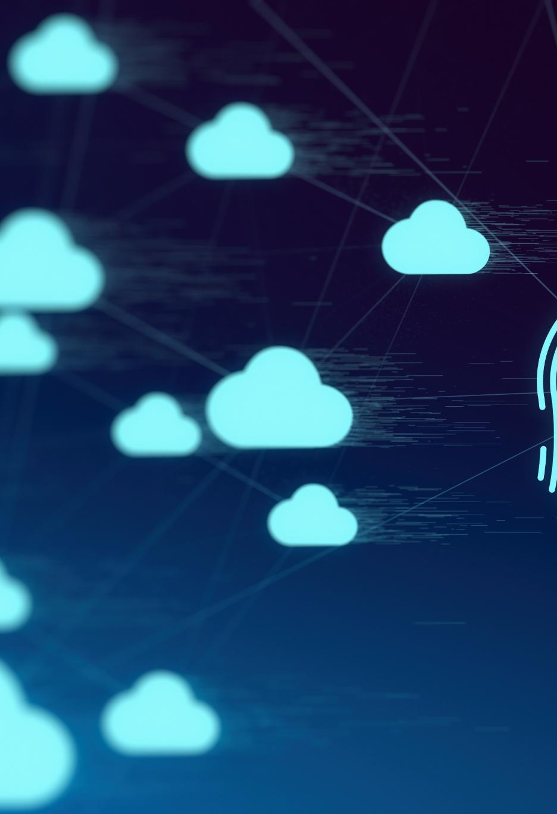
Security Changes in the Cloud
Removal of Physical Access
Cloud environments eliminate physical access to infrastructure, changing traditional security approaches significantly.
API-Driven Infrastructure
Cloud infrastructure is managed through APIs, requiring new security strategies focused on software controls.
Identity as Core Security
Identity management becomes central to cloud security, emphasizing robust authentication and access control.
Importance of Configuration
Proper configuration and access management are critical to maintaining security in cloud environments.
Notes:
This slide explains why cloud security differs from traditional environments. Physical access is removed, infrastructure is API-driven, and identity becomes the core security control, increasing the importance of configuration and access management.

Slide 21
Shared Responsibility Model
Cloud Provider Responsibilities
Cloud providers handle security of physical data centers and infrastructure to ensure reliable service delivery.
Customer Responsibilities
Customers manage data protection, identity management, and application security within the cloud environment.
Division of Responsibilities
The model clearly defines shared security duties between cloud providers and customers for effective risk management.
Notes:
This slide formally introduces the shared responsibility model. Cloud providers secure the physical data center and infrastructure, while customers remain responsible for data protection, identity, and application security. A visual diagram reinforces this division.

Slide 22
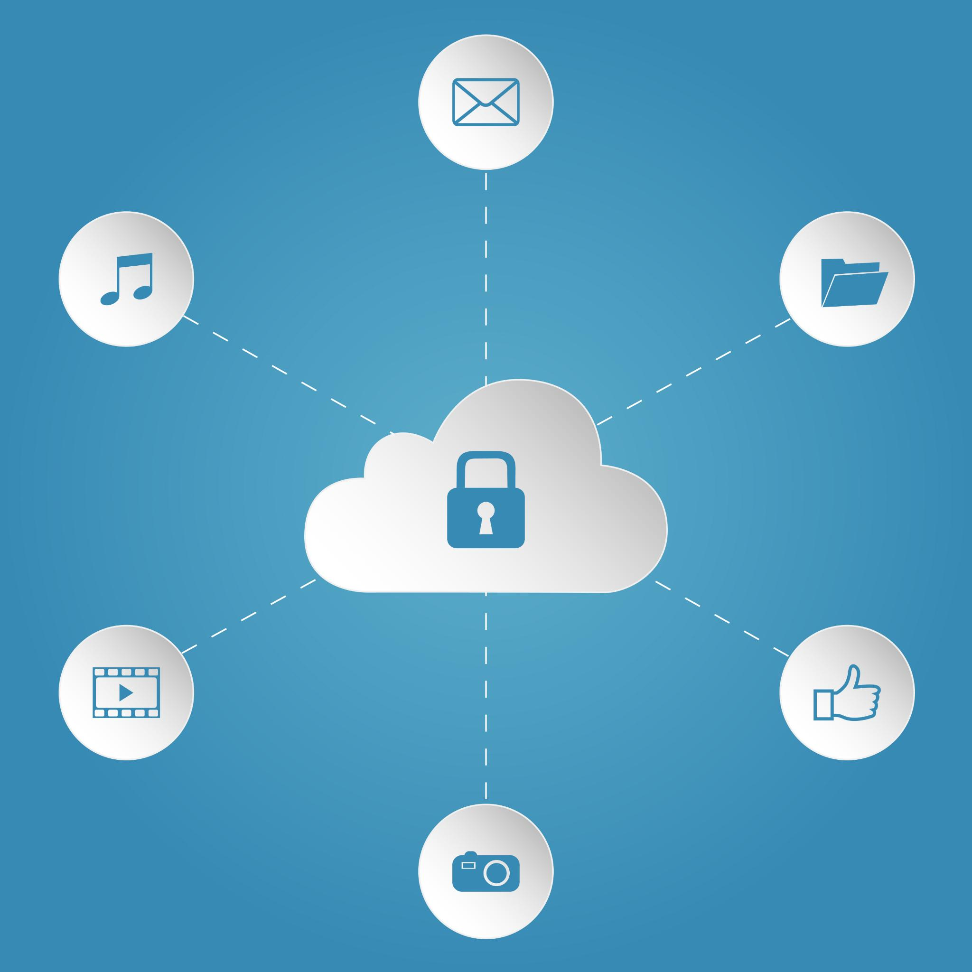
Responsibility in IaaS
Customer Responsibilities
Customers must manage OS patching, firewall settings, and application security to protect their infrastructure.
Importance of Operational Practices
Strong operational practices are essential for maintaining security in lower-abstraction cloud services like IaaS.
Notes:
In IaaS, customers are responsible for OS patching, firewall configuration, and application vulnerabilities. This reinforces the need for strong operational and security practices in lower-abstraction cloud models.

Slide 23

Responsibility in PaaS
Provider Responsibilities
PaaS providers manage the operating system and runtime environment to ensure platform stability and scalability.
Customer Responsibilities
Customers are responsible for securing application code and defining access control policies to protect their applications.
Notes:
This slide shows how responsibilities shift in PaaS: providers manage OS and runtime, while customers are responsible for application code security and access control policies.

Slide 24

Identity as the New Perimeter
End of Traditional Perimeters
Network perimeters no longer define security boundaries in modern cloud environments, requiring new protection methods.
Zero Trust Verification
Zero Trust mandates verification of every access request, eliminating implicit trust within networks.
Role-Based Access Control
RBAC ensures access permissions are granted based on user identity and role, not network location.
Notes:
Traditional network perimeters no longer define security boundaries in the cloud. Zero Trust approaches require verification of every access request. Role-Based Access Control ensures permissions are based on identity and role rather than network location.

Slide 25
What Is Azure?
Global Cloud Platform
Azure operates globally with numerous data centers providing cloud services across multiple regions for scalability and reliability.
IaaS, PaaS, SaaS Services
Azure offers Infrastructure as a Service, Platform as a Service, and Software as a Service to support diverse computing needs.
Practical Application Context
Azure provides the practical context for cloud computing concepts discussed throughout the lecture.
Notes:
Azure is Microsoft’s global cloud platform offering IaaS, PaaS, and SaaS services across dozens of regions. It provides the practical context for all concepts discussed in the lecture.

Slide 26
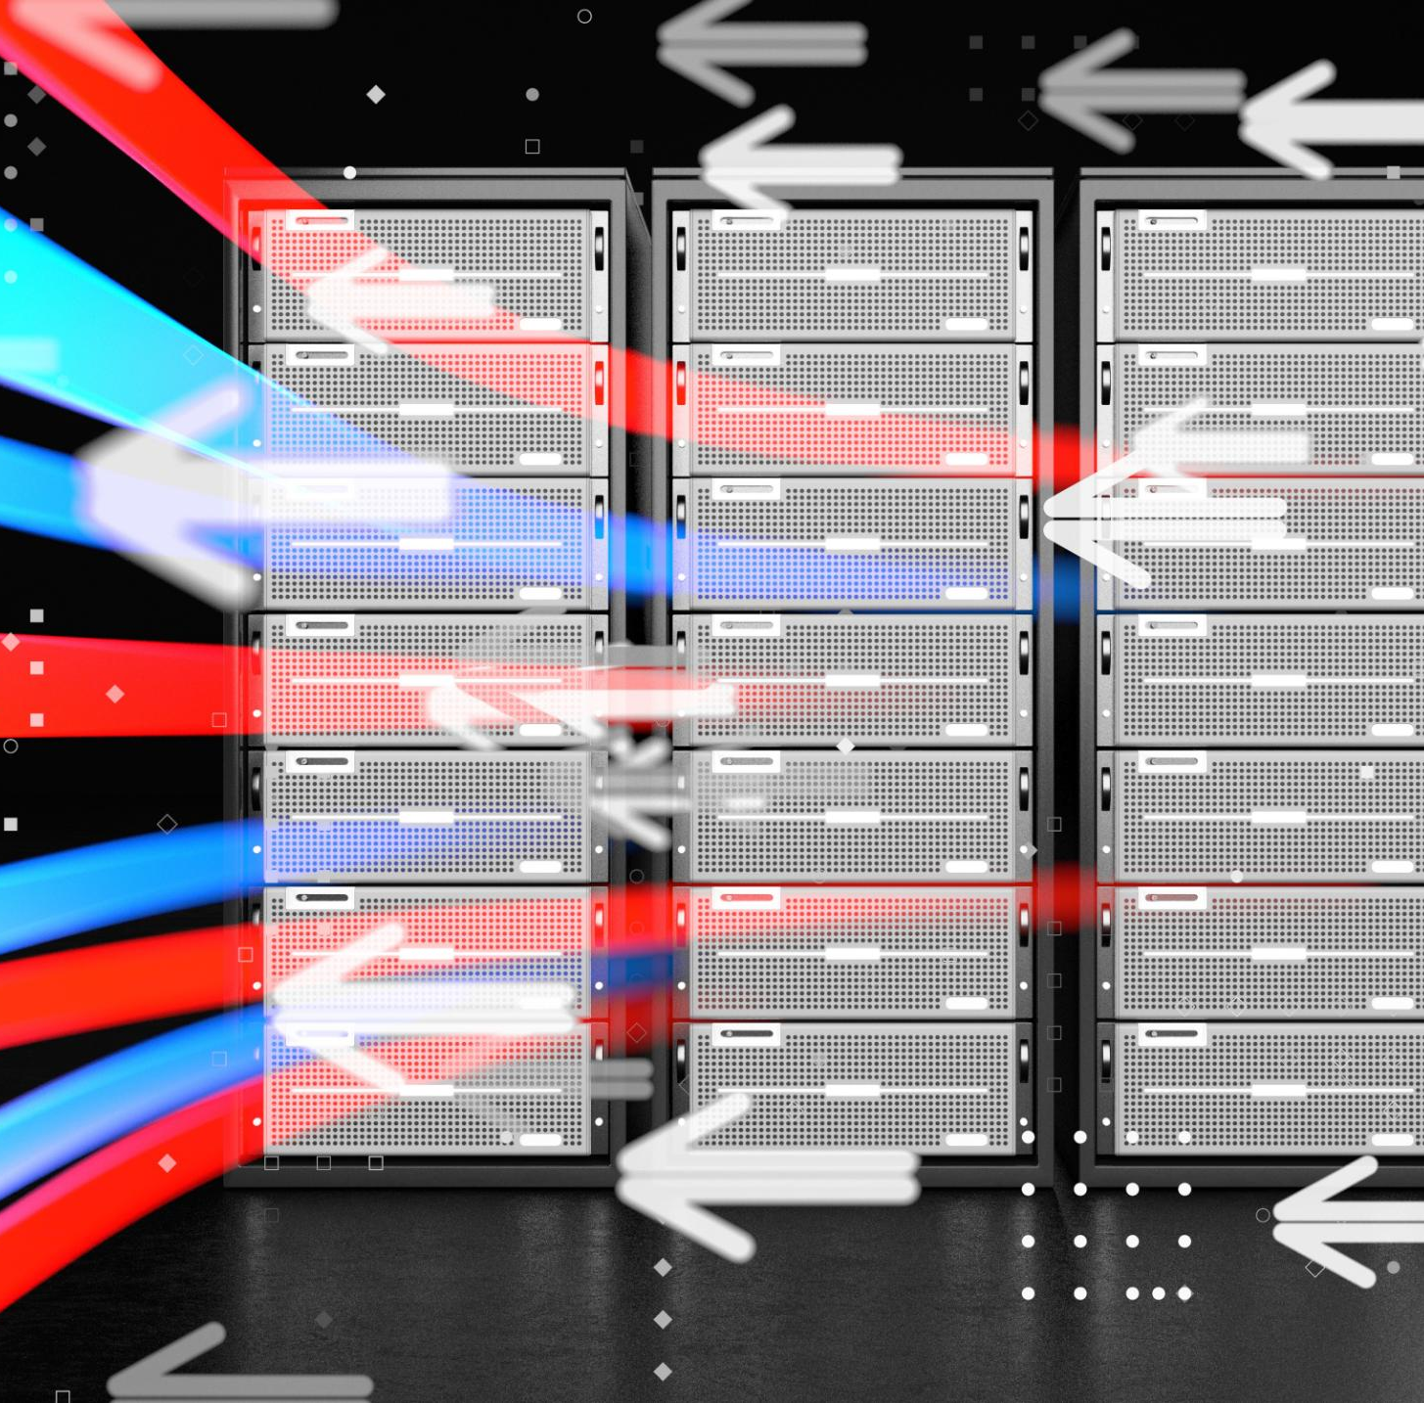
Azure Global Infrastructure
Azure Regions
Azure regions are geographic locations housing multiple data centers to deliver cloud services closer to users.
Availability Zones
Availability zones provide fault isolation within regions to enhance system reliability and uptime.
Data Residency
Data residency features help organizations comply with local data privacy and regulatory requirements.
Notes:
This slide explains Azure regions, availability zones, and data residency features. These concepts support high availability, fault tolerance, and regulatory compliance.

Slide 27
Core Azure Service Categories
Compute Services
Azure compute services provide scalable processing power for applications and workloads in the cloud.
Storage Solutions
Storage services offer secure and scalable options for data storage and backup in the cloud.
Networking Services
Networking services enable secure and efficient connectivity within cloud environments and to on-premises resources.
Databases and Security
Databases store structured data securely, while security services protect cloud assets from threats.
DevOps Integration
DevOps services streamline development and operations for faster cloud application delivery.
Notes:
Azure services are grouped into compute, storage, networking, databases, security, and DevOps. Understanding these categories helps structure cloud architecture designs.

Slide 28

Azure Compute Services
Virtual Machines
Azure offers virtual machines providing scalable and customizable computing power for various workloads and applications.
Serverless Computing
Azure Functions enable serverless computing, allowing code execution without managing infrastructure, optimizing resource usage.
Managed Container Platforms
Managed container services in Azure support containerized applications with orchestration and easy scaling.
Notes:
Azure compute options range from virtual machines to fully serverless solutions such as Azure Functions and managed container platforms. This diversity supports different architectural needs.

Slide 29
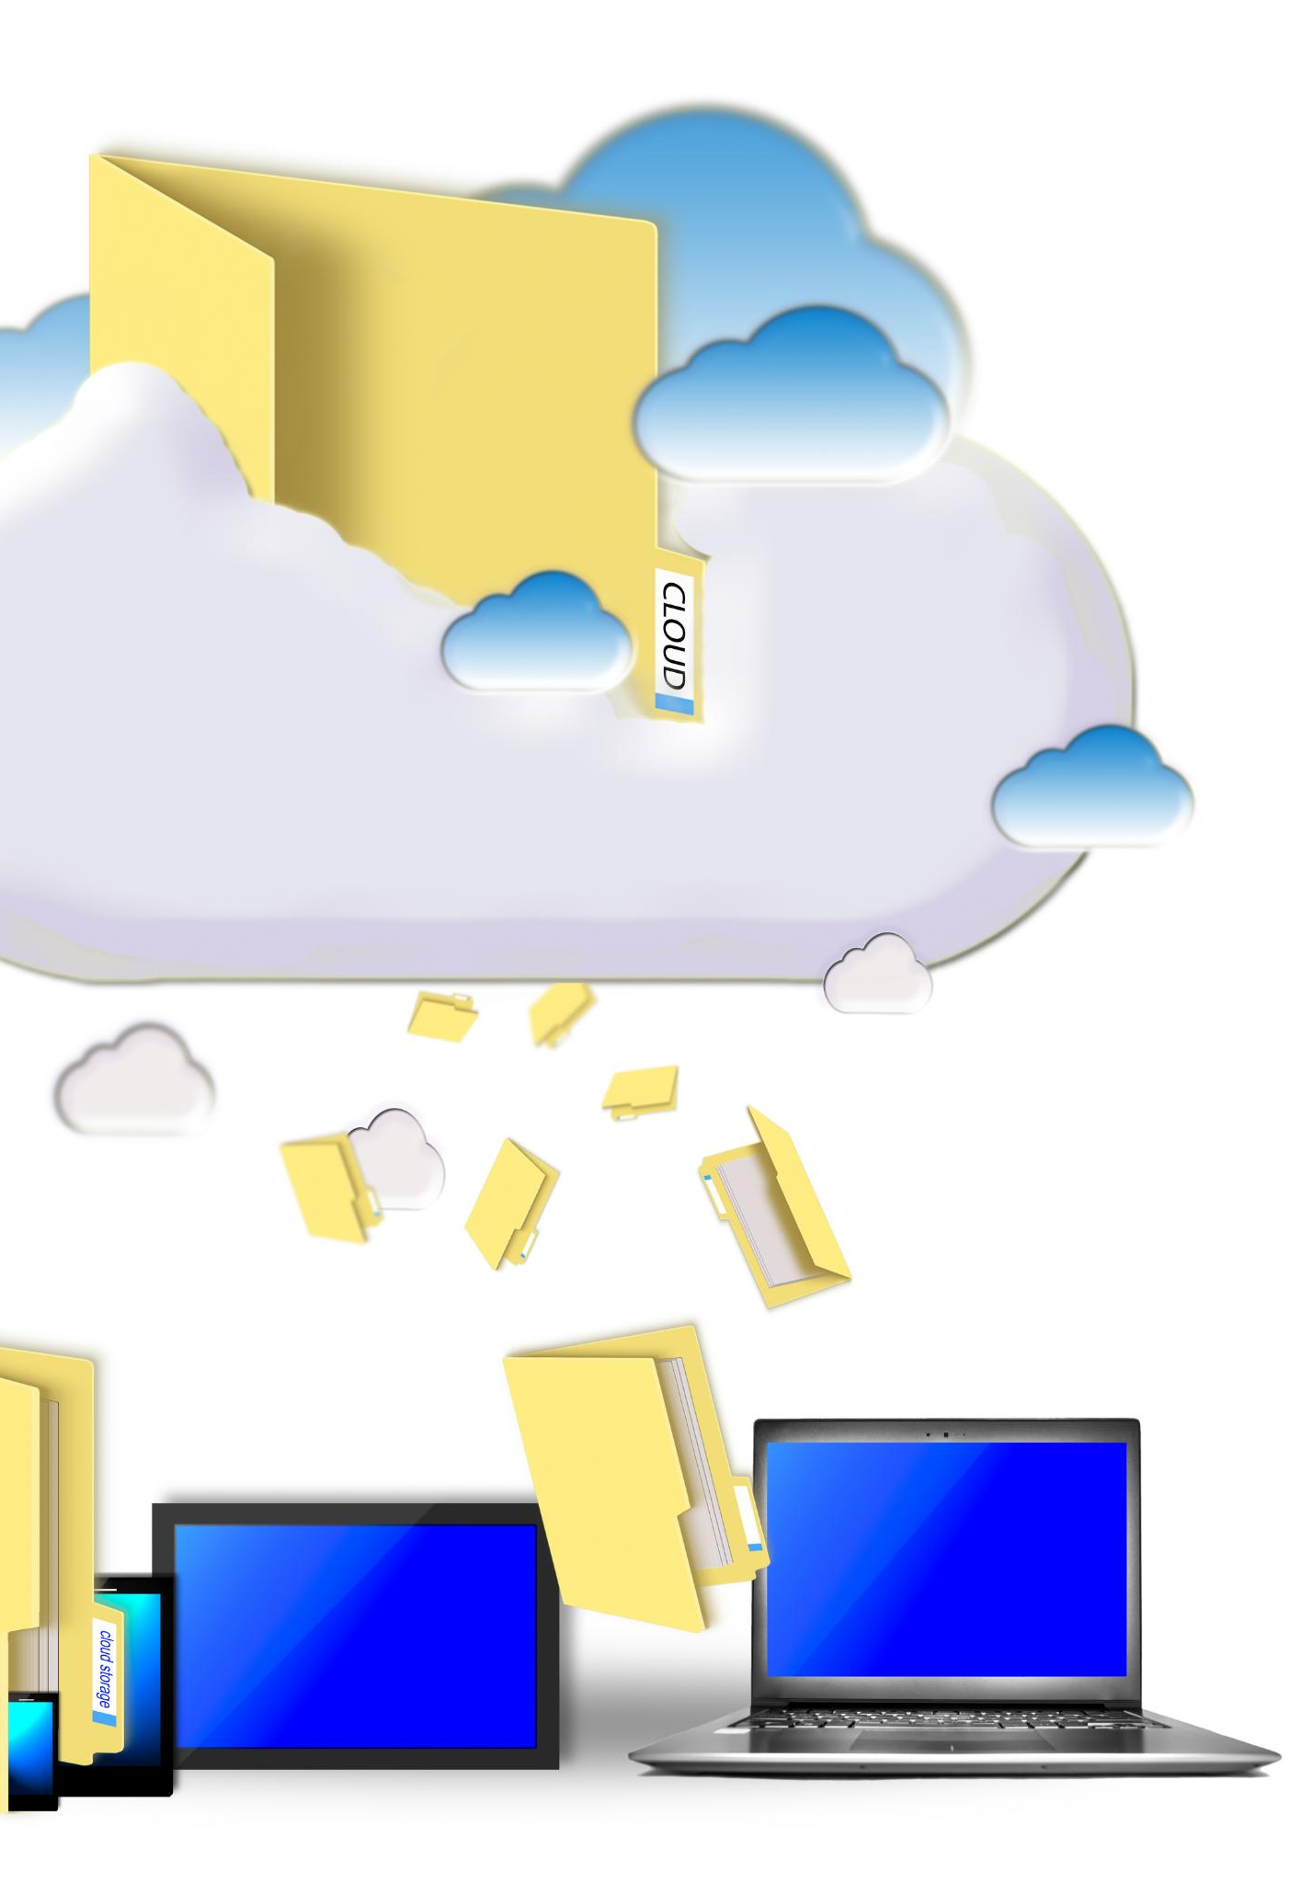
Azure Storage Services
Object Storage
Azure offers scalable object storage for unstructured data like images and videos accessible via HTTP.
File Storage
File storage provides managed file shares accessible via SMB protocol for traditional applications.
Queue Storage
Queue storage enables message queuing for asynchronous communication between application components.
Key-Value Storage
Key-value storage supports fast access to data using unique keys, ideal for caching and session data.
Notes:
Azure storage services provide object, file, queue, and key-value storage options, supporting a wide range of application data patterns.

Slide 30
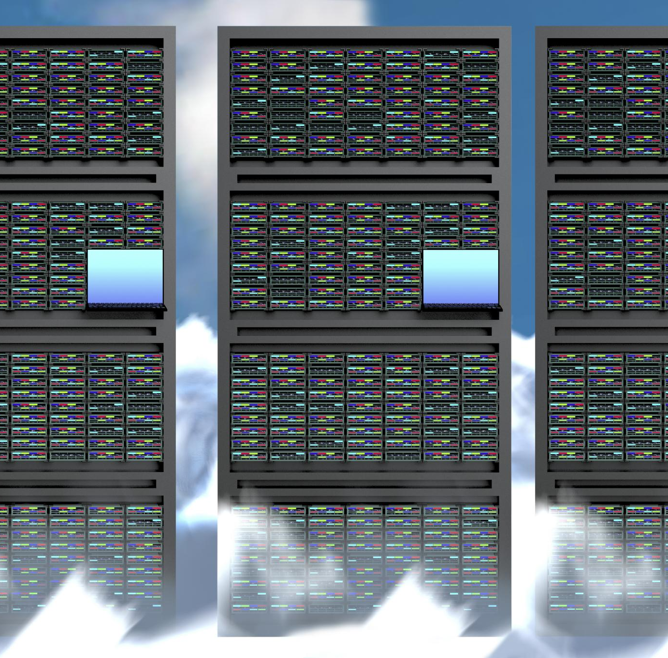
Azure Database Services
Managed Relational Databases
Azure provides managed relational databases like Azure SQL Database and managed PostgreSQL to simplify database management tasks.
NoSQL Database Service
Azure Cosmos DB offers a globally distributed NoSQL database service for flexible and scalable data storage.
Reduced Administration Overhead
Azure managed databases reduce administration overhead, allowing businesses to focus on application development.
Notes:
Azure offers managed relational and NoSQL databases such as Azure SQL Database, Cosmos DB, and managed PostgreSQL, reducing database administration overhead.

Slide 31
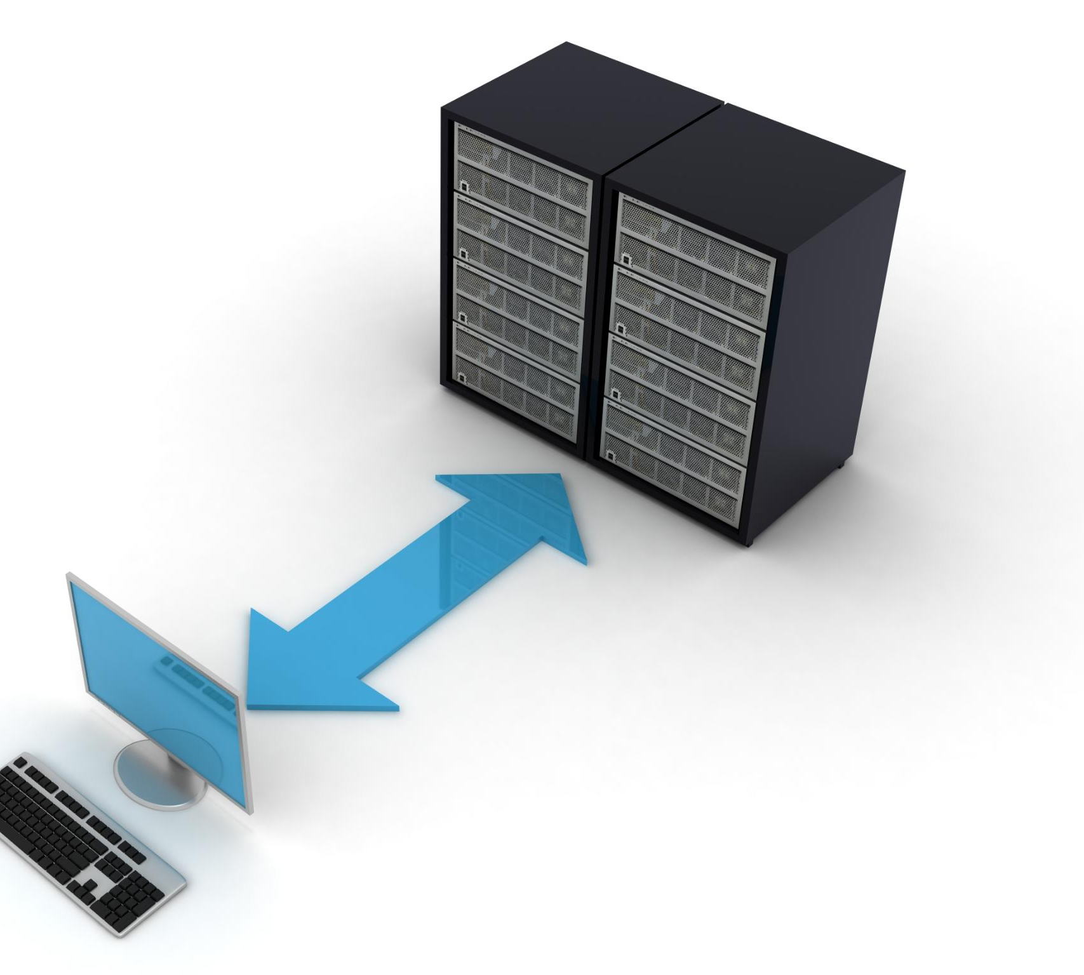
Azure Networking Basics
Virtual Networks
Virtual Networks enable secure and isolated network environments in the cloud for resource communication.
Load Balancers
Load balancers distribute incoming network traffic across multiple resources to enhance availability and reliability.
Application Gateways
Application gateways provide traffic routing and security controls to protect and optimize web applications.
Notes:
Core networking components include Virtual Networks, load balancers, and application gateways. These services provide connectivity, traffic distribution, and security controls.

Slide 32

Azure Identity
Centralized Identity Management
Azure Active Directory provides centralized management of user identities across cloud services and applications.
Role-Based Access Control
It supports role-based access control to ensure secure and appropriate resource access based on user roles.
Managed Identities
Managed identities enable secure authentication for applications without embedded credentials, enhancing security.
Notes:
Azure Active Directory enables centralized identity management, role-based access control, and managed identities, eliminating the need for embedded credentials.

Slide 33
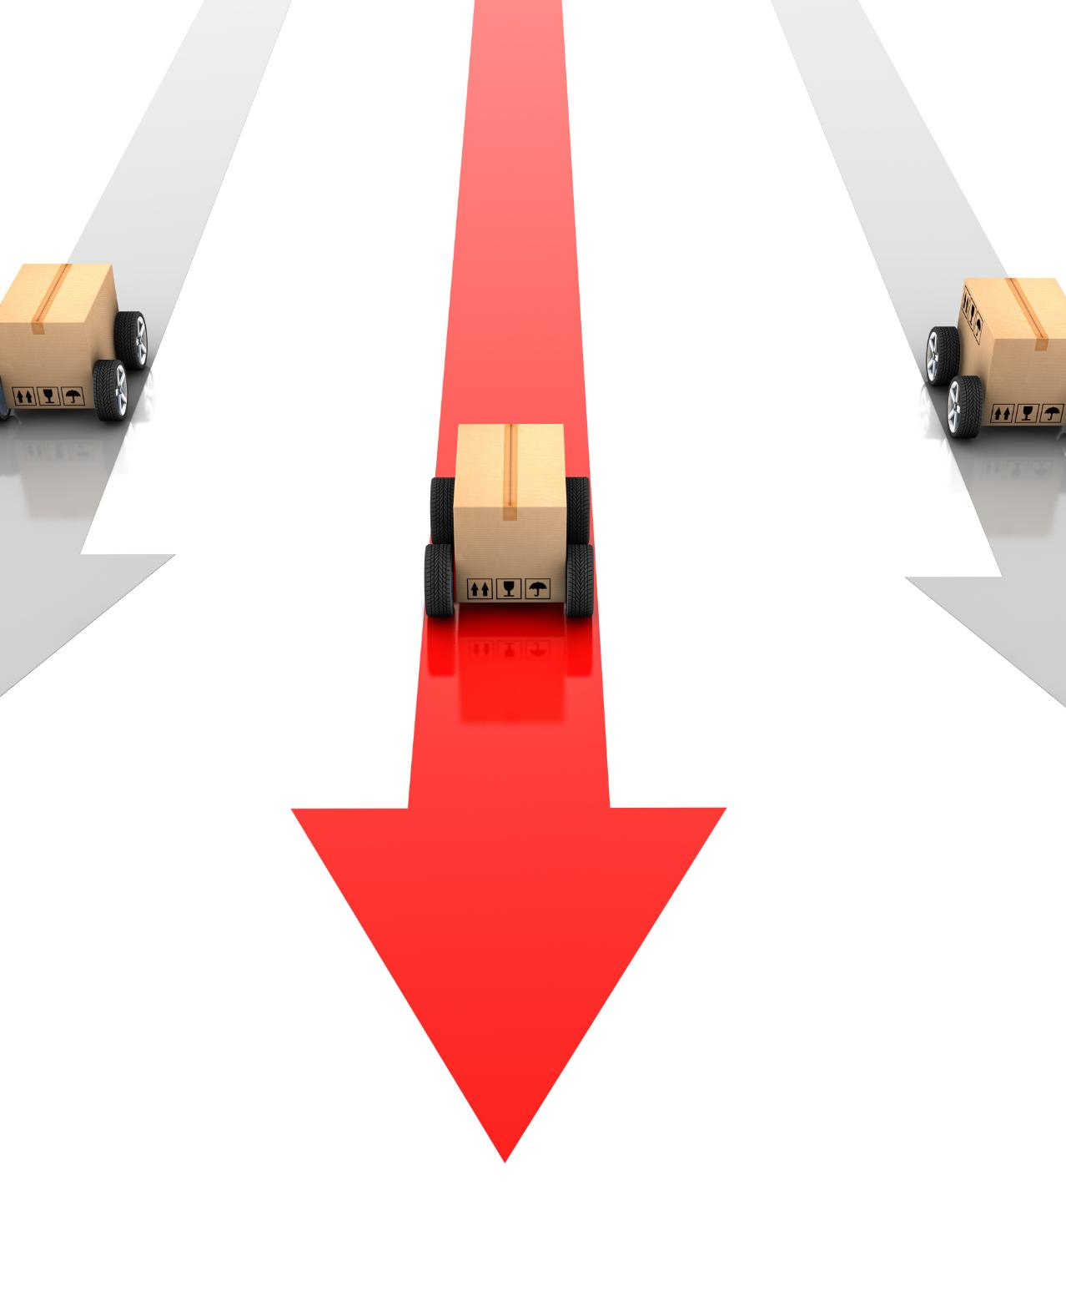
Azure DevOps and CI/CD
Integration with GitHub and Azure DevOps
Azure seamlessly integrates with GitHub and Azure DevOps to streamline software development workflows.
Automated Build Pipelines
Automated build pipelines enable efficient, consistent code compilation and testing for faster delivery.
Continuous Integration and Delivery
Continuous integration and delivery practices ensure reliable deployment of code changes to production.
Notes:
Azure integrates with GitHub and Azure DevOps to support automated build and deployment pipelines, enabling continuous integration and delivery practices.

Slide 34

Typical Cloud Application Architecture
Frontend Component
The frontend handles user interactions and sends requests to the backend services through the API layer.
API Layer
The API layer manages communication between frontend and backend, routing requests and responses effectively.
Database Component
The database stores, retrieves, and manages data critical for application functionality and user information.
Authentication and Monitoring
Authentication secures user access, while monitoring tracks application performance and reliability.
Notes:
This slide presents a common cloud architecture with frontend, API layer, database, authentication, and monitoring components. The diagram helps visualize request flow and system responsibilities.

Slide 35

Cost Model in the Cloud
Pay-As-You-Go Pricing
Cloud pricing charges are based on actual resource consumption, enabling flexible and scalable usage.
Reserved Instances
Reserved instances offer discounted rates for pre-committed cloud resource usage, reducing long-term costs.
Right-Sizing Resources
Right-sizing ensures efficient cloud resource allocation by matching capacity with actual needs to optimize costs.
Notes:
Cloud pricing is based on pay-as-you-go consumption. Cost optimization techniques such as reserved instances and right-sizing help control expenses.

Slide 36

Cloud Advantages
Elastic Scalability
Cloud computing provides elastic scalability to adjust resources based on demand quickly and efficiently.
Global Reach
Cloud services offer global reach, enabling businesses to operate and serve customers worldwide seamlessly.
Automation and Resilience
Built-in automation and resilience in the cloud support continuous availability and rapid innovation.
Notes:
Advantages include elastic scalability, global reach, automation, and built-in resilience, enabling rapid business growth and innovation.

Slide 37

Cloud Challenges
Vendor Lock-In
Vendor lock-in limits flexibility by making it hard to switch cloud providers or platforms.
Security Misconfigurations
Security misconfigurations increase vulnerabilities and risks of data breaches in cloud environments.
Cost Overruns
Hidden and unexpected costs cause cloud spending to exceed budgets and estimates.
System Complexity
Distributed systems add complexity, making cloud management and troubleshooting challenging.
Notes:
Challenges include vendor lock-in, security misconfigurations, cost overruns, and the inherent complexity of distributed systems.

Slide 38

What Changes for Developers?
Infrastructure-as-Code Adoption
Developers use code to manage and provision cloud infrastructure efficiently and reliably.
DevOps Practices
Integrating development and operations teams accelerates software delivery and improves collaboration.
Monitoring-First Approach
Developers prioritize monitoring to proactively detect and resolve issues in cloud systems.
Distributed Systems Design
Designing systems to run across multiple cloud nodes enhances scalability and resilience.
Notes:
Developers adopt infrastructure-as-code, DevOps practices, monitoring-first approaches, and distributed system designs in cloud environments.

Slide 39
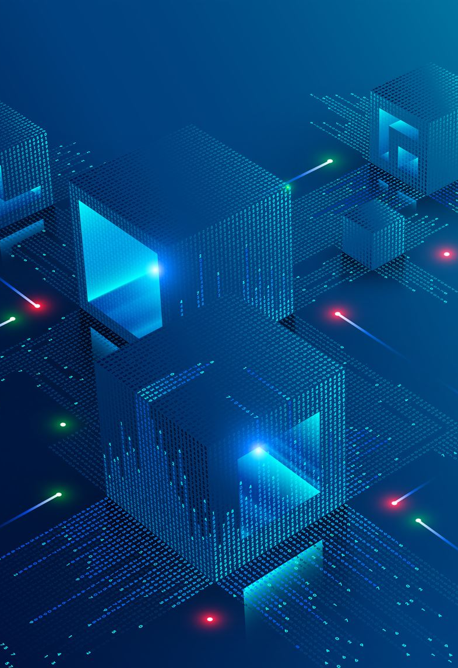
Cloud-Native Mindset
Stateless Architecture
Cloud-native applications are designed to be stateless, allowing easy scaling and recovery from failures.
API-First Design
API-first approach ensures seamless communication and integration between different cloud services and components.
Automated Deployment
Automatic deployment enables continuous delivery and rapid updates of cloud-native applications.
Observability and Resilience
Built-in observability supports monitoring and resilience, ensuring high availability and performance.
Notes:
Cloud-native applications are stateless, API-first, automatically deployed, and observable by design, enabling high scalability and resilience.

Slide 40
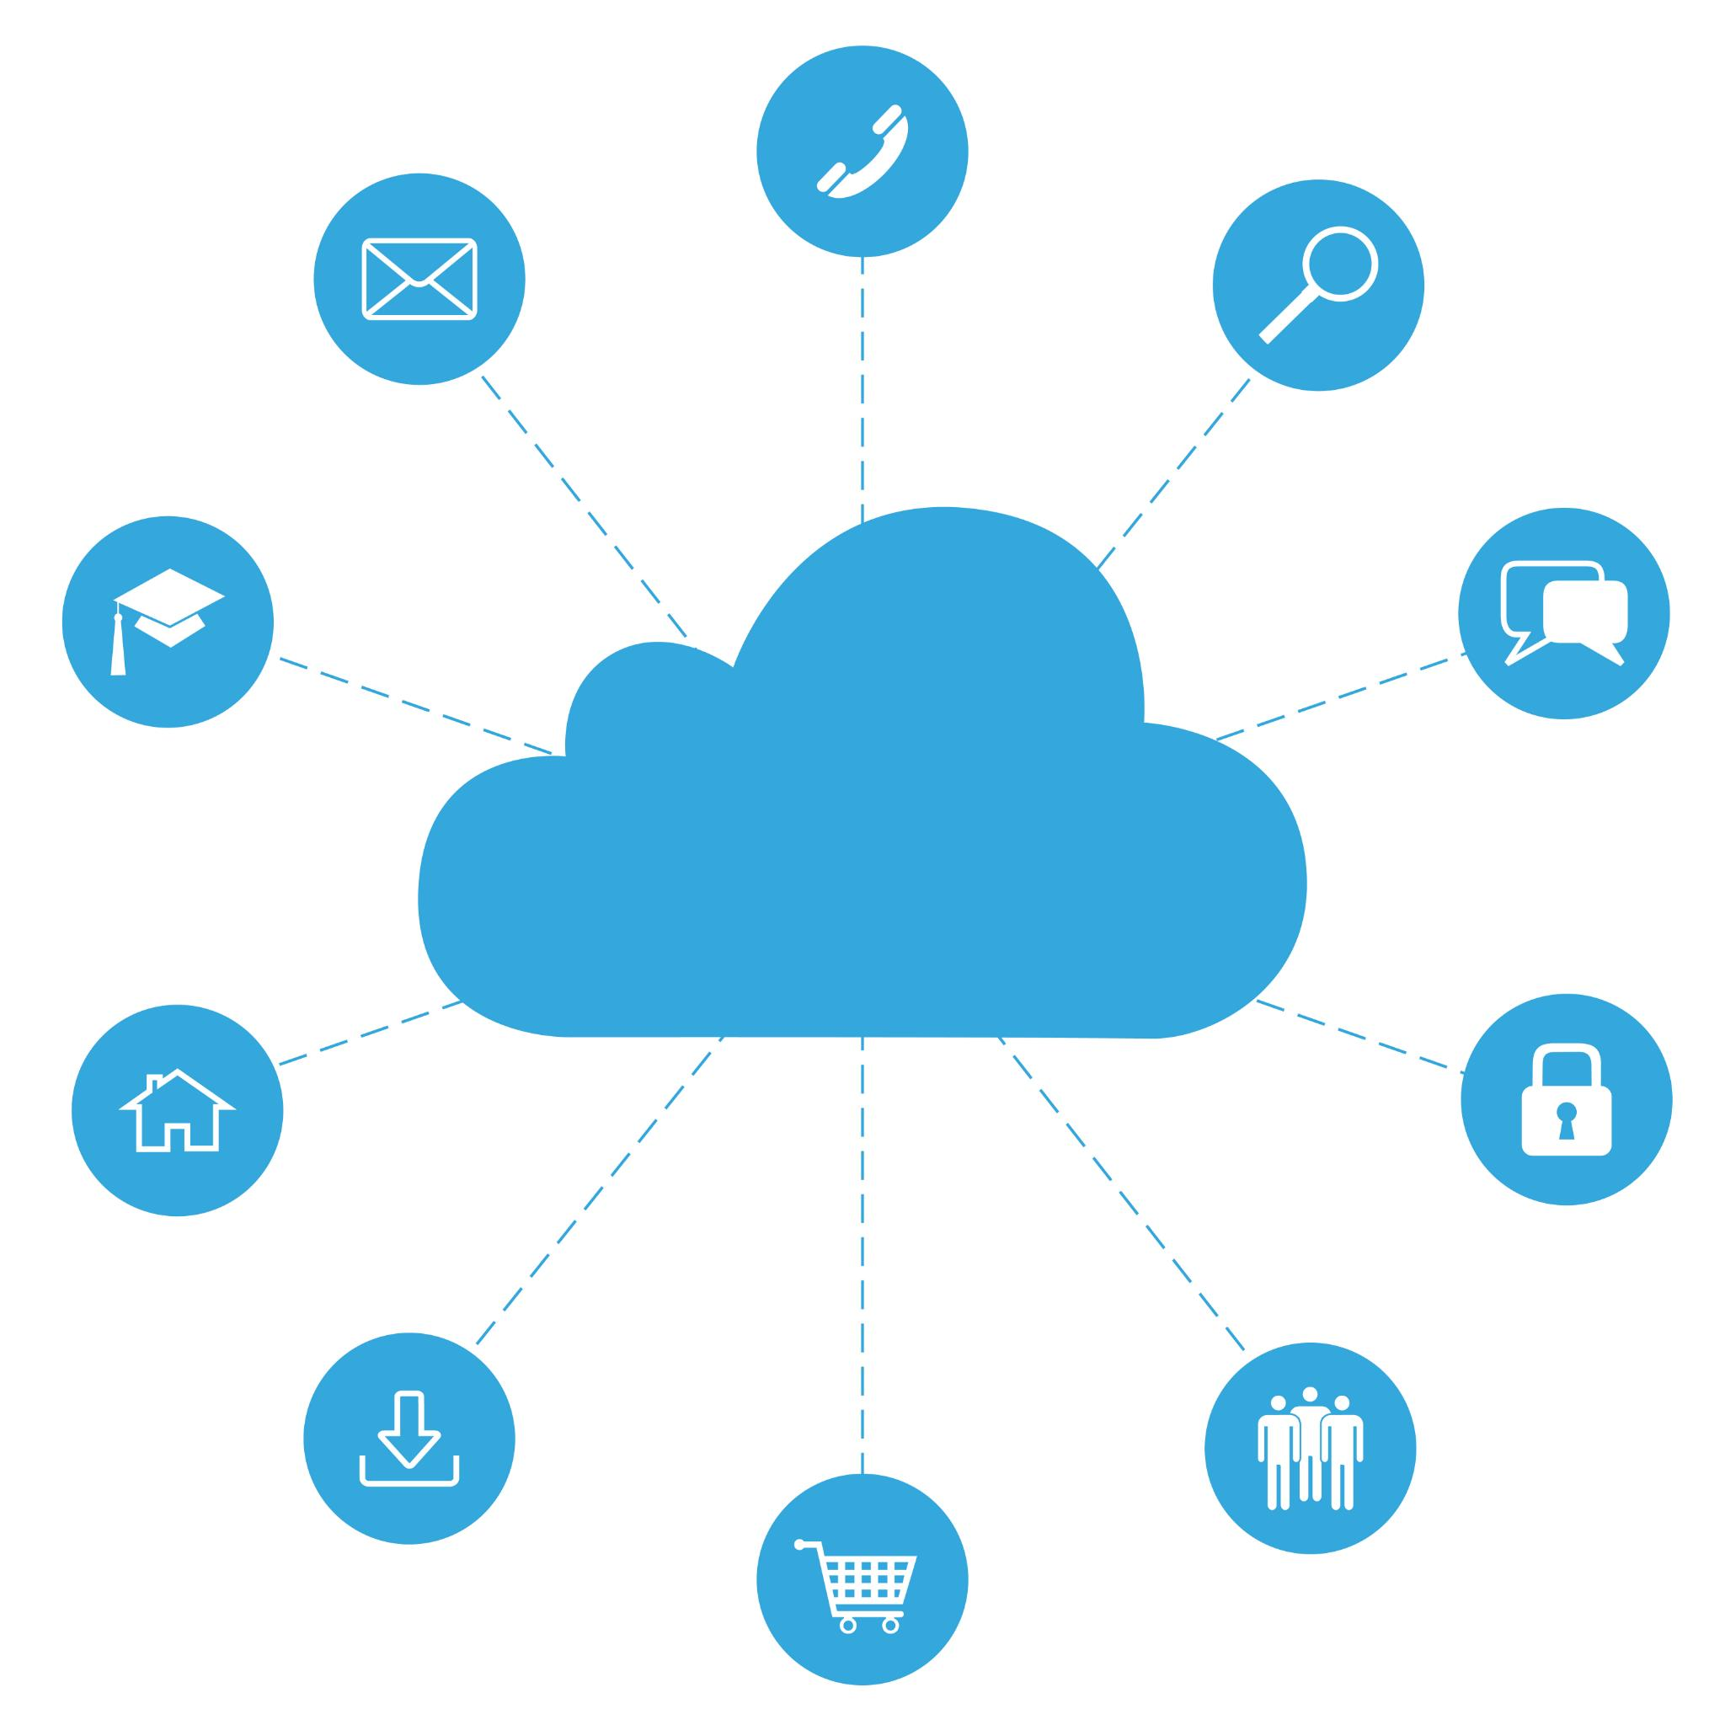
Key Takeaways
Service Models Overview
Service models define how cloud resources are provided and managed, shaping user interaction and control.
Deployment Models
Deployment models specify how cloud infrastructure is deployed, influencing accessibility and control.
Shared Responsibility Model
Shared responsibility defines security and management roles between cloud providers and users.
Azure Building Blocks
Azure components provide foundational elements for building scalable and secure cloud solutions.
Notes:
Understanding service models, deployment models, shared responsibility, and Azure building blocks forms the foundation for cloud architecture decisions.

Slide 41
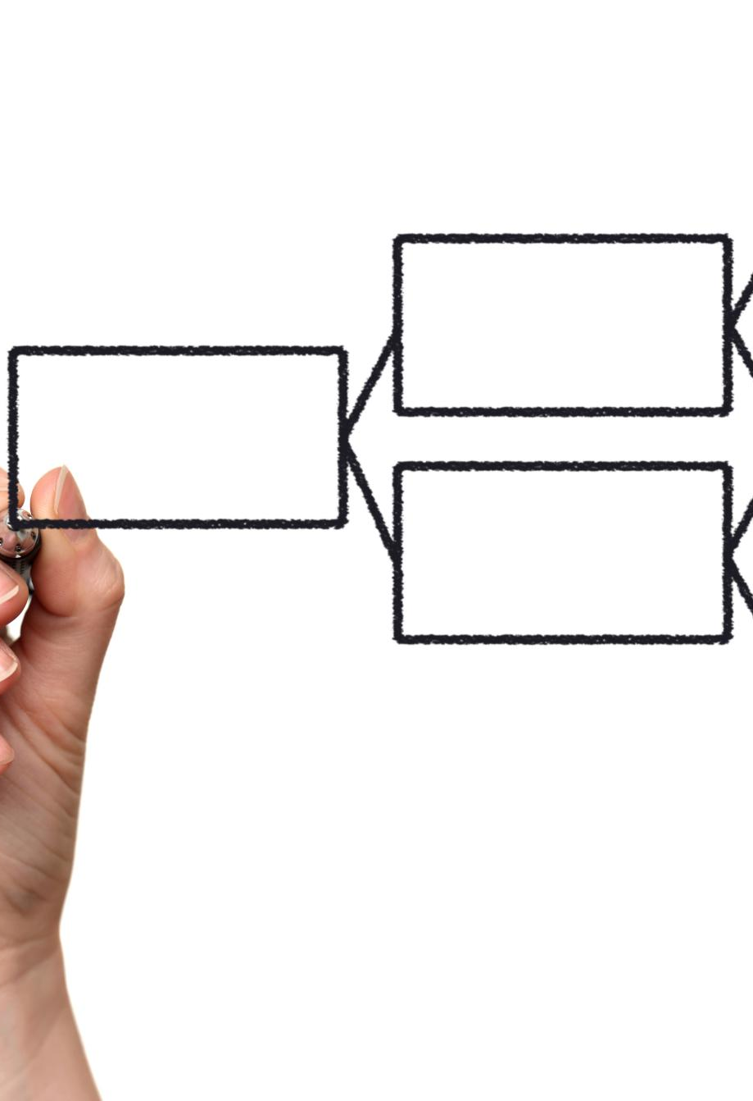
Next Lecture Preview
Cloud Architecture Principles
Core principles guide efficient and resilient cloud architecture design for modern applications.
12-Factor Applications
The 12-Factor methodology standardizes building cloud-native applications for portability and scalability.
Stateless Design
Stateless application design enhances scalability and reliability by avoiding persistent server states.
Scaling Patterns
Scaling patterns enable applications to handle varying workloads efficiently in cloud environments.
Notes:
The next lecture introduces cloud architecture principles, 12-Factor applications, stateless design, and scaling patterns as core cloud-native practices.

