Slide 1
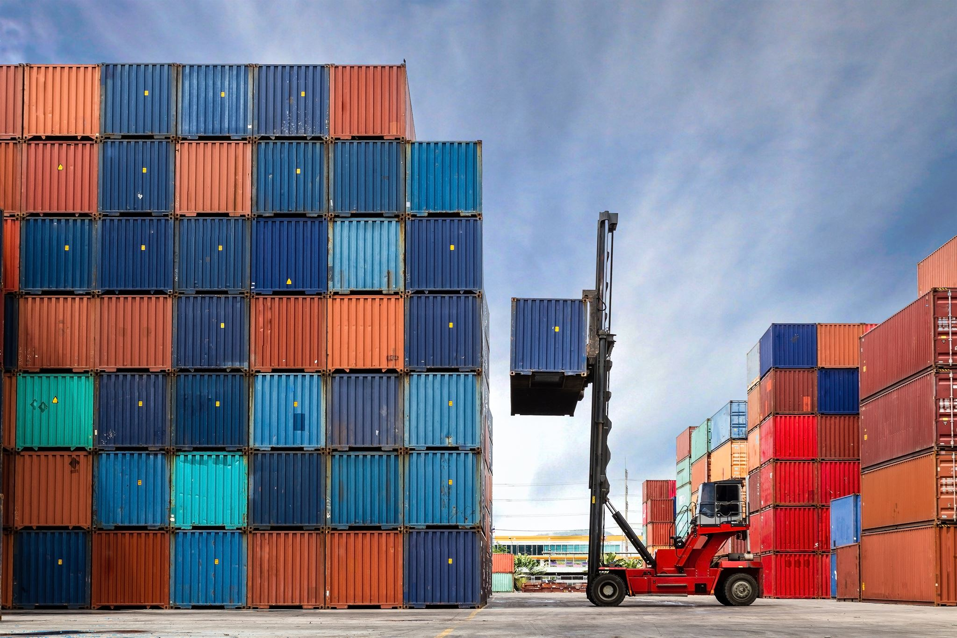
L4 – Containerization & Deployment
Modern approaches to software packaging and delivery
Notes:
AI-generated content may be incorrect. ---

Slide 2
Containerization & Deployment Overview
Notes:
Title Slide – Containerization & Deployment, What Is Containerization?, Containers vs Virtual Machines, What Is Docker?, Docker Concepts, Dockerfile Basics, Example Dockerfile, Docker Build Process, Docker Run, Container Lifecycle, Stateless Containers, Persisting Data, Container Networking, Microservices + Containers, Container Registries, Public vs Private Registries, CI/CD and Containers, Container Orchestration, Why Orchestration Is Needed, Basic Kubernetes Concepts, Containers in Cloud Platforms, Azure Container Services Overview, Azure Container Instances, Azure App Service for Containers, Azure Kubernetes Service (AKS), Deployment Strategies, Environment Configuration, Security Basics, Observability, Summary

Slide 3
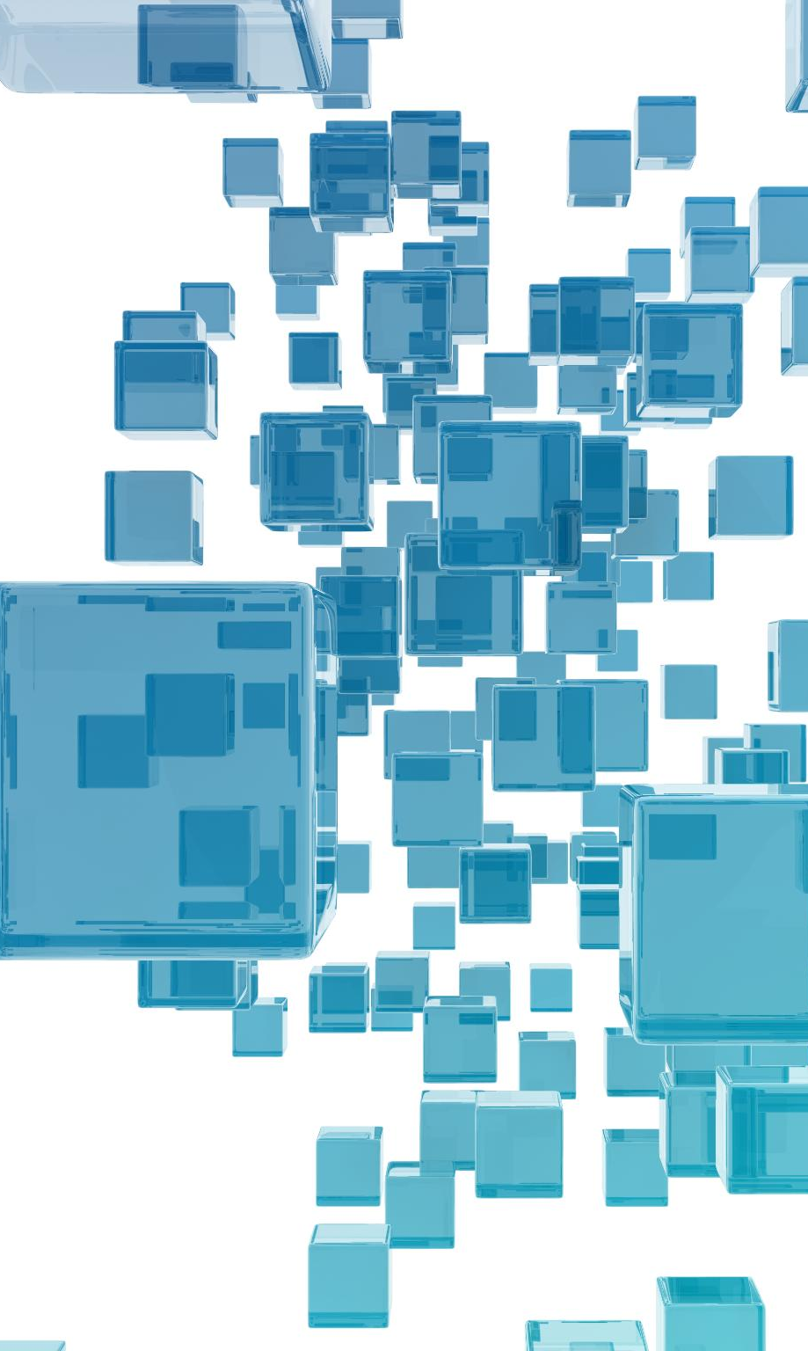
Title Slide – Containerization & Deployment
Definition of Containerization
Containerization packages applications with dependencies to run reliably across all computing environments.
Benefits of Portability
Containers enable application portability by allowing reuse of the same container image everywhere.
Scalability and Consistency
Containerization supports running multiple application instances efficiently and ensures environment consistency.
Strategic Role in Cloud Native
Containerization is a key enabler for cloud-native architectures and DevOps practices.
Notes:
This opening slide introduces the concept of containerization and deployment as a foundational topic in modern cloud computing. Containerization refers to the process of packaging applications together with their dependencies so they can run reliably across different computing environments. This includes local development machines, testing environments, and production cloud platforms. The slide emphasizes why containerization matters in practice: it enables application portability, meaning the same container image can be reused everywhere; scalability, allowing applications to run multiple instances efficiently; and consistency, ensuring that discrepancies between development and production environments are minimized. These characteristics directly address common problems such as environment-related bugs and manual deployment errors. The slide sets the context for the lecture by framing containerization not as a tooling detail, but as a strategic enabler for cloud-native architectures and DevOps practices.

Slide 4
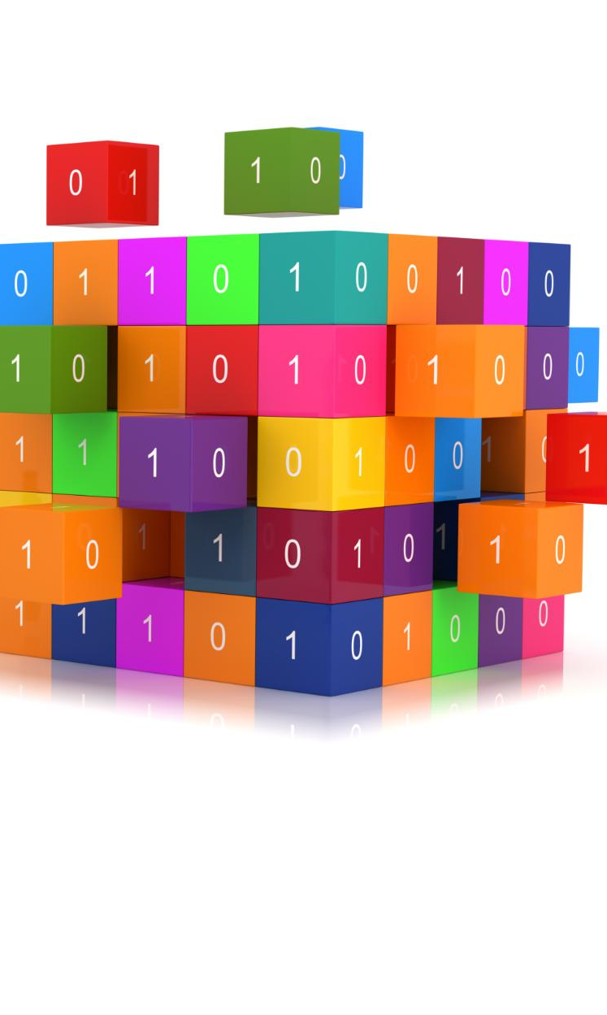
What Is Containerization?
Packaging Applications
Containerization packages applications with all dependencies, ensuring consistent execution across environments.
Lightweight Virtualization
Containers share the host OS kernel, making them faster and more resource-efficient than traditional VMs.
Consistent Runtime Environment
Containers provide a uniform runtime environment, reducing deployment issues and improving CI/CD reliability.
Cloud-native Building Block
Containerization is fundamental for cloud-native system design and modern application deployment.
Notes:
This slide explains containerization as the practice of packaging an application together with all of its required dependencies, including libraries, runtime components, and configuration. By bundling everything into a single unit, containers ensure that the application can run the same way regardless of where it is deployed. The concept of lightweight virtualization is introduced, highlighting that containers share the host operating system kernel rather than running a full operating system for each instance. This makes them faster to start and more resource-efficient than traditional virtual machines. The slide also stresses the importance of a consistent runtime environment, which reduces deployment friction and makes CI/CD pipelines more reliable. Altogether, containerization is presented as a key building block of cloud-native system design.

Slide 5
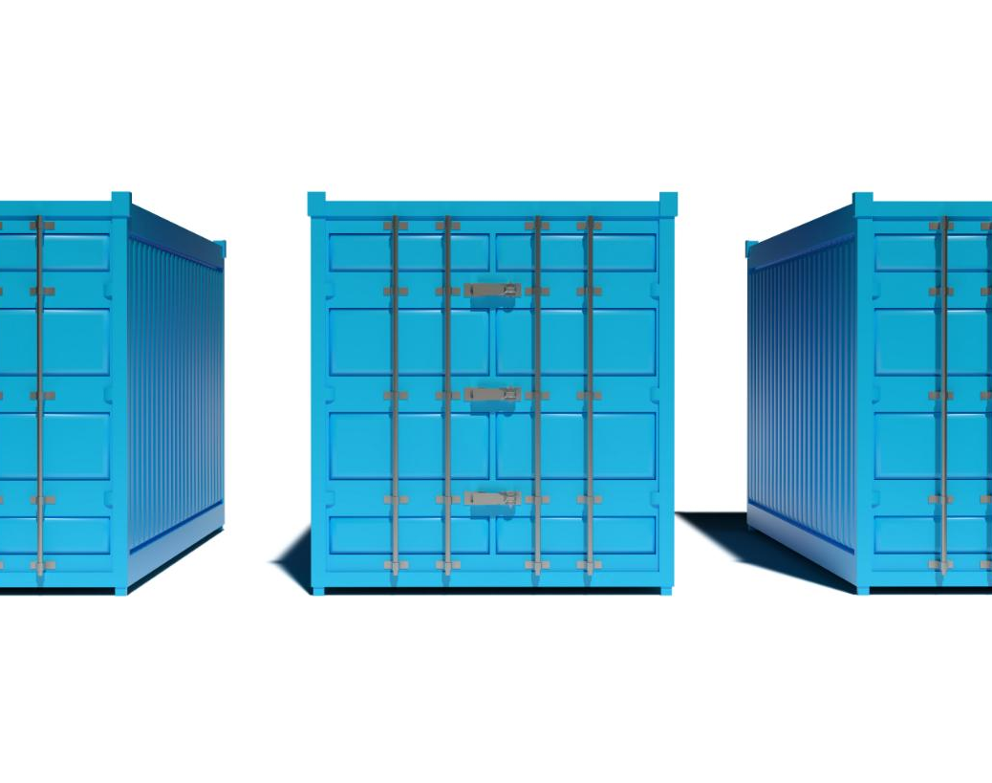
Containers vs Virtual Machines
Virtual Machines Overview
Virtual machines run full operating systems, consuming more resources and having slower startup times.
Containers Overview
Containers share the host OS kernel and isolate applications, enabling faster startup and lighter resource use.
Resource Efficiency
Containers use less CPU and memory, allowing higher density and better scalability on the same infrastructure.
Notes:
This slide compares containers and virtual machines to clarify their differences and use cases. Virtual machines are described as heavy-weight solutions where each instance includes a full operating system, leading to higher resource consumption and slower startup times. Containers, in contrast, share the host OS kernel and isolate applications at the process level, which makes them much lighter and faster to start. The slide emphasizes resource efficiency, noting that containers typically use less CPU and memory, allowing higher density on the same infrastructure. This comparison helps learners understand why containers are often preferred in modern cloud environments, especially for microservices and scalable workloads.

Slide 6
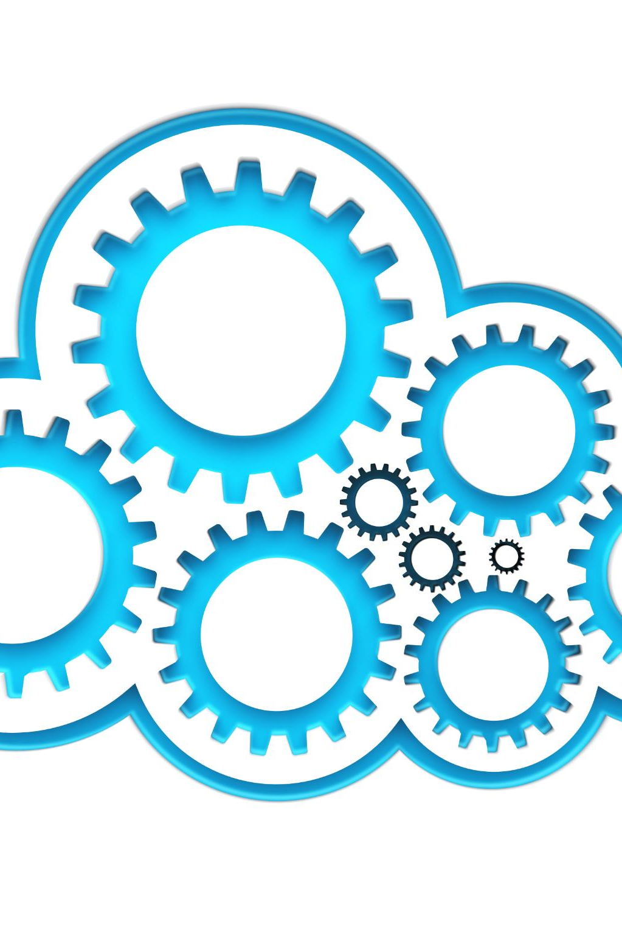
What Is Docker?
Docker Platform Overview
Docker is the leading containerization platform used for building, running, and managing containers efficiently.
Images vs Containers
Images are immutable templates, while containers are running instances created from these images.
Standardization and Portability
Docker standardizes application packaging, enabling portable and reproducible deployments across environments.
Notes:
This slide introduces Docker as the most widely used containerization platform. Docker provides tools to build, run, and manage containers in a standardized way. It has become the de facto standard in the container ecosystem, supported by a large community and integrated into most cloud platforms and CI/CD systems. The slide explains the distinction between images and containers, where images serve as immutable templates and containers are the running instances created from those images. By standardizing how applications are packaged and executed, Docker plays a central role in enabling portable and reproducible deployments.

Slide 7
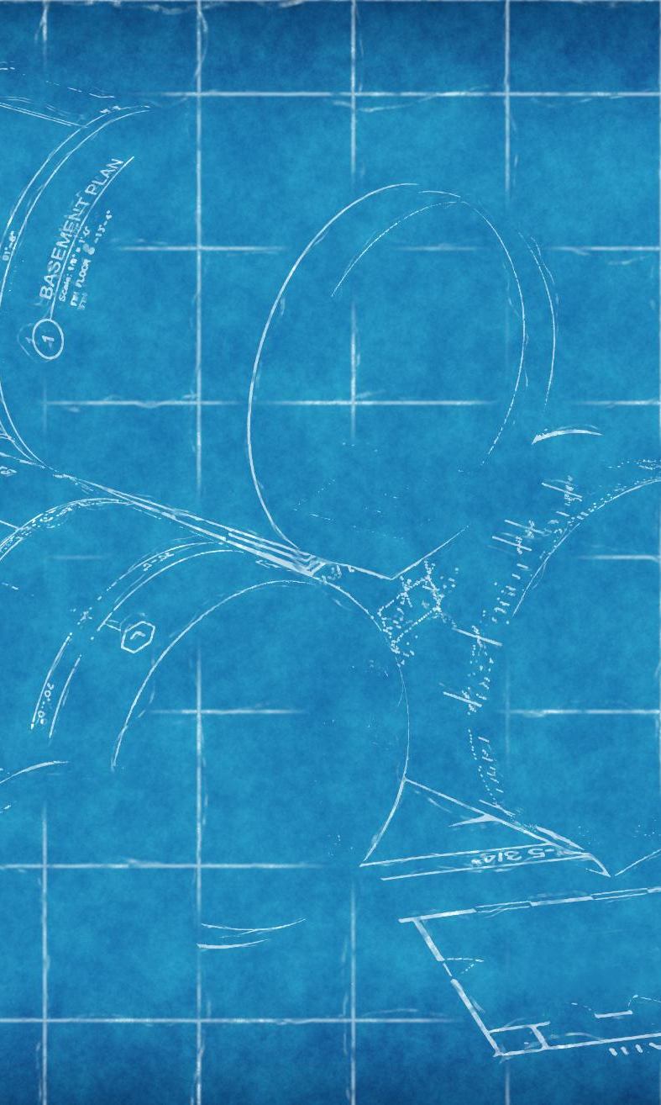
Docker Concepts
Docker Image
A Docker image is a read-only template defining an application, its dependencies, and environment.
Docker Container
A container is a running instance of an image, representing live execution of the application.
Dockerfile Script
The Dockerfile is a step-by-step script defining how to build a Docker image.
Importance of Concepts
Together, these concepts enable repeatable builds, consistent runtimes, and automation across environments.
Notes:
This slide outlines the core concepts used in Docker. An image is defined as a read-only template that specifies the application, its dependencies, and its environment. A container is a running instance of an image, representing the actual execution of the application. The Dockerfile is introduced as a script that defines how an image is built, step by step. Understanding these concepts is essential because they form the mental model used when working with Docker-based systems. Together, images, containers, and Dockerfiles enable repeatable builds, consistent runtime behavior, and automation across environments.

Slide 8
Dockerfile Basics
Base Image Definition
The FROM instruction sets the base image, providing the foundational runtime environment for the container.
Working Directory Setup
WORKDIR sets the working directory inside the container, defining where commands will run.
File Transfer
COPY transfers files from the host system into the container image during the build process.
Command Execution
RUN executes commands during image build, often used for installing dependencies and configuring software.
Default Container Command
CMD defines the default command executed when the container starts, specifying the application startup behavior.
Notes:
This slide explains the most common Dockerfile instructions used to build container images. FROM defines the base image, such as a specific language runtime. WORKDIR sets the working directory inside the container. COPY transfers files from the host into the image. RUN executes commands during the image build process, often used to install dependencies. CMD defines the default command that runs when the container starts. These instructions together describe how an application environment is constructed in a deterministic and automated way.

Slide 9
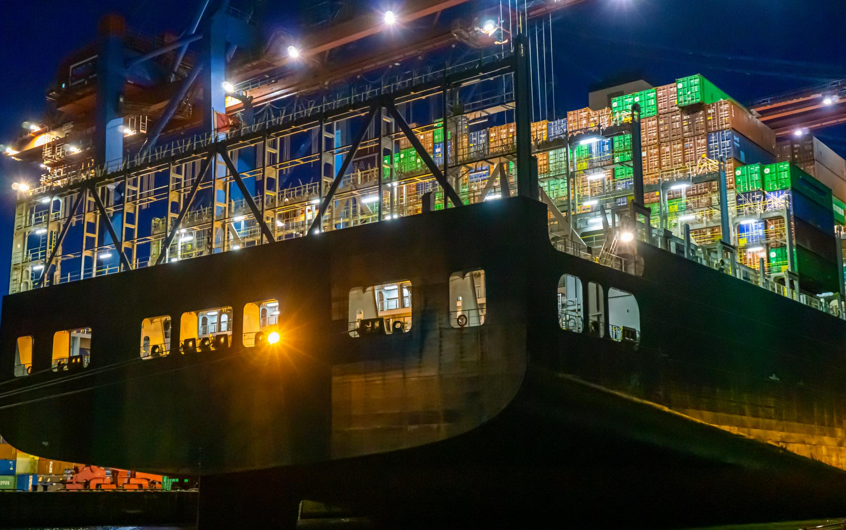
Example Dockerfile
Node.js Base Image
The Dockerfile starts by selecting a Node.js base image to provide the runtime environment for the application.
Setting Working Directory
The working directory inside the container is set to organize the application files and run commands efficiently.
Installing Dependencies
Dependency files are copied and installed to ensure all required packages for the Node.js API are available.
Application Startup Command
The CMD instruction specifies the command to start the Node.js application when the container runs.
Notes:
This slide presents a concrete example of a Dockerfile for a Node.js API. It shows how a Node.js base image is selected, how the working directory is configured, how dependency files are copied and installed, and how the application source code is added. Finally, the CMD instruction specifies the command used to start the application. The explanation highlights that this Dockerfile builds a container capable of running a Node.js backend service, illustrating how abstract concepts translate into a real, usable configuration.

Slide 10
Docker Build Process
Dockerfile Instructions Create Layers
Each Dockerfile instruction generates a separate layer in the image, forming a layered architecture.
Layer Caching Speeds Builds
Docker caches unchanged layers to reuse them, significantly speeding up subsequent image builds.
Image Reuse Enhances Efficiency
Shared layers across images reduce storage use and improve build efficiency for multiple projects.
Notes:
This slide describes how the docker build command creates an image from a Dockerfile. Each instruction in the Dockerfile results in a layer, forming a layered architecture that supports caching. If certain layers have not changed, Docker can reuse them, making subsequent builds much faster. The concept of image reuse is emphasized, showing how shared layers reduce storage usage and improve efficiency across multiple builds and projects.

Slide 11

Docker Run
Starting Containers
The docker run command initiates a container from a given image for application deployment or testing.
Port Mapping
Port mapping links container ports to host machine ports, enabling external access to containerized services.
Detached Mode
Detached mode allows containers to run in the background without occupying the terminal session.
Notes:
This slide focuses on running containers using the docker run command. It explains that this command starts a container from a specified image. Port mapping is highlighted as a way to connect container ports to host ports, enabling external access to services. Detached mode is also discussed, allowing containers to run in the background. These options illustrate how containers are executed and interacted with in practice.

Slide 12
Container Lifecycle
Lifecycle Stages
Containers go through creation, starting, stopping, and removal stages similar to a process lifecycle.
Ephemeral Nature
Containers are ephemeral and typically short-lived, designed to be transient and replaced frequently.
Stateless Behavior
Containers are stateless, meaning data should not be stored inside unless persisted externally for reliability.
Notes:
This slide introduces the lifecycle of a container, which includes creation, starting, stopping, and removal. Containers are compared to processes in this regard. Their ephemeral nature is emphasized, noting that containers are typically short-lived. Stateless behavior is also discussed, reinforcing that data should not be stored inside containers unless explicitly persisted elsewhere.

Slide 13
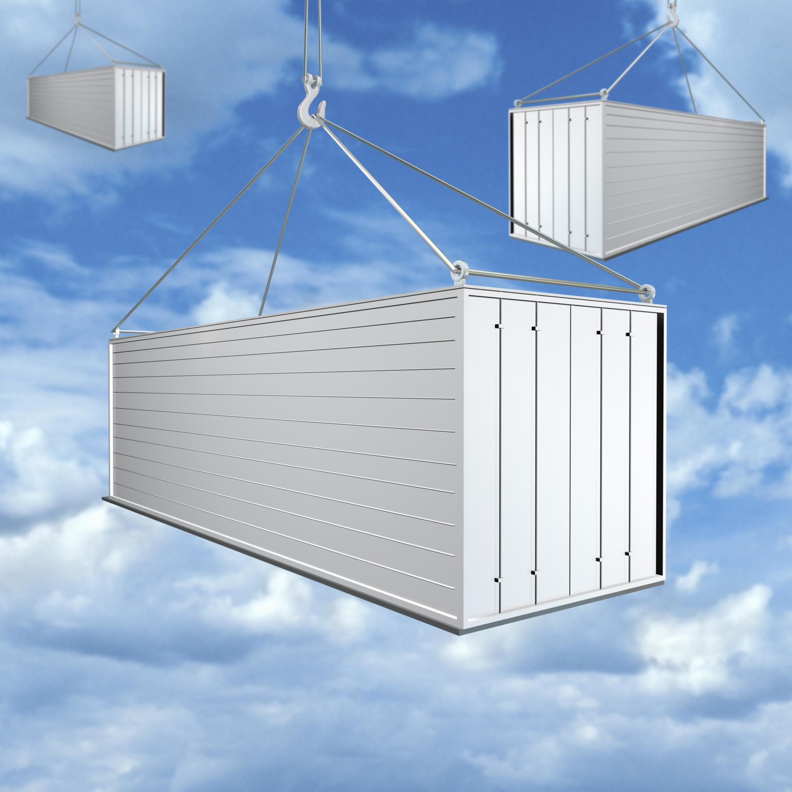
Stateless Containers
Stateless Container Design
Containers should not store important data internally to allow easy replacement and updates.
Horizontal Scaling
Replaceable container instances enable horizontal scaling to handle increased workload efficiently.
Cloud-Native Resilience
Treating infrastructure as disposable supports graceful recovery from failures in cloud-native systems.
Notes:
This slide explains why containers should be stateless by design. Storing important data inside containers is discouraged because containers can be stopped and replaced at any time. Replaceable instances enable horizontal scaling and resilience. This approach aligns with cloud-native design principles, where infrastructure is treated as disposable and systems are built to recover gracefully from failures.

Slide 14
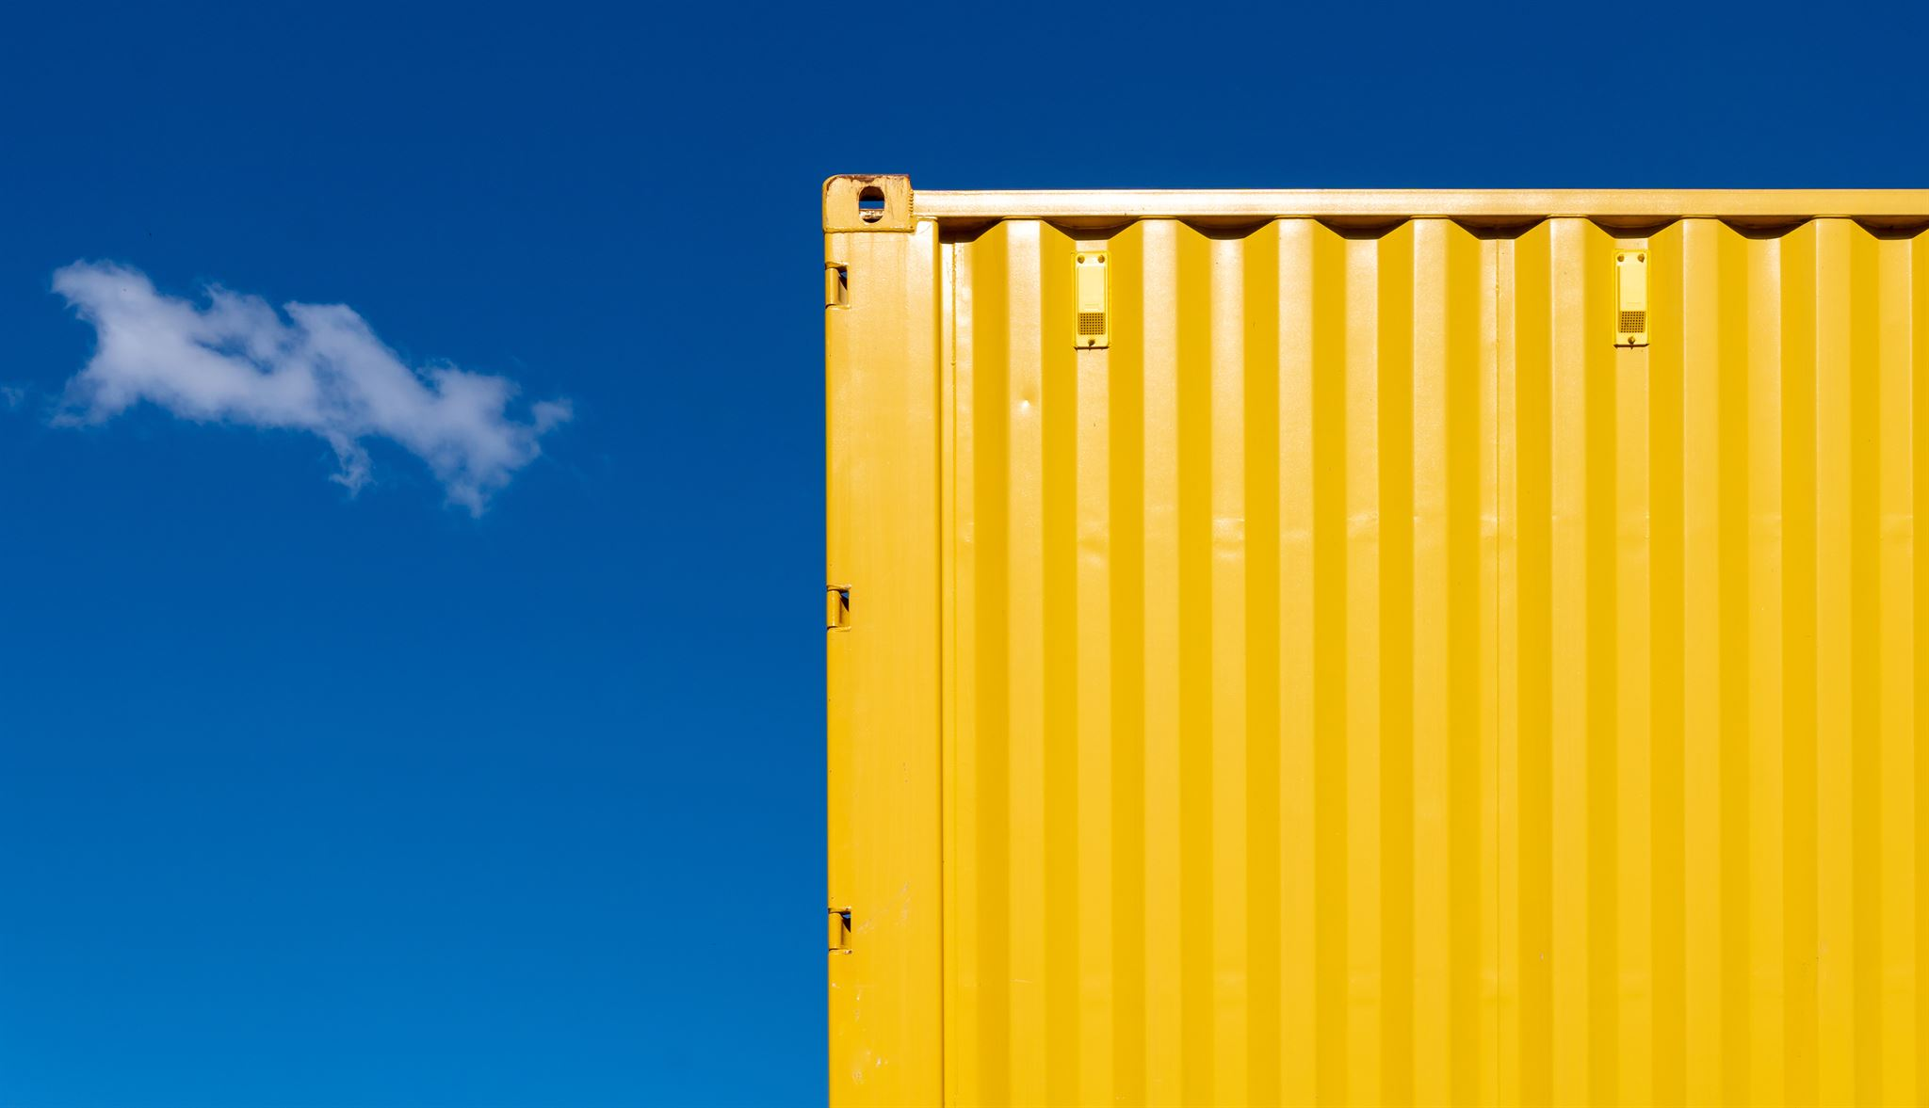
Persisting Data
Volumes as External Storage
Volumes provide external storage attached to containers to persist data beyond container lifetimes.
Bind Mounts Mapping
Bind mounts map host directories into containers for direct access to host files and directories.
Data Persistence Importance
Persisting data ensures important information survives container restarts and removals reliably.
Separation of Compute and Storage
Separating compute and storage is a core practice in container systems for scalable, reliable applications.
Notes:
This slide introduces mechanisms for persisting data when using containers. Volumes are described as external storage attached to containers, while bind mounts map host directories into containers. The slide explains why these mechanisms are needed: to ensure that important data survives container restarts and removals. This separation of compute and storage is a core practice in containerized systems.

Slide 15
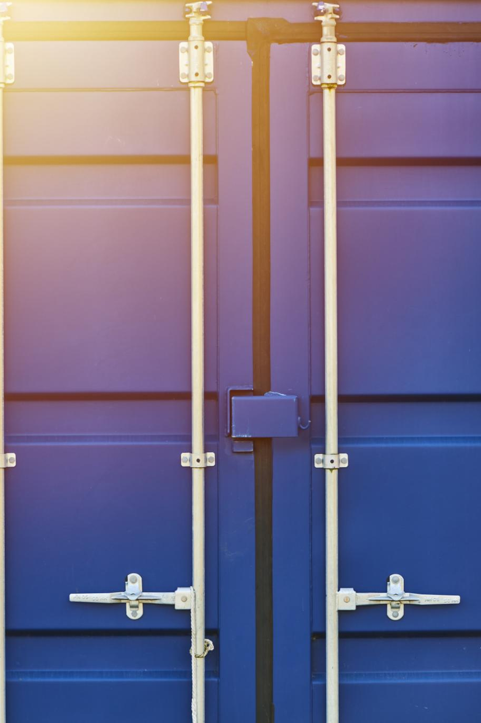
Container Networking
Isolated Network Namespaces
Containers run in isolated network namespaces by default, enhancing security and preventing interference.
Port Exposure for Access
Ports must be explicitly exposed on containers to allow communication with external networks and users.
Internal Container Communication
Containers communicate internally over networks, enabling efficient service-to-service interactions in microservices.
Notes:
This slide describes how container networking works. Containers run in isolated network namespaces by default, improving security and isolation. Ports must be explicitly exposed to allow external communication. The slide also notes that containers can communicate with each other through internal networks, enabling service-to-service interaction in microservice architectures.

Slide 16
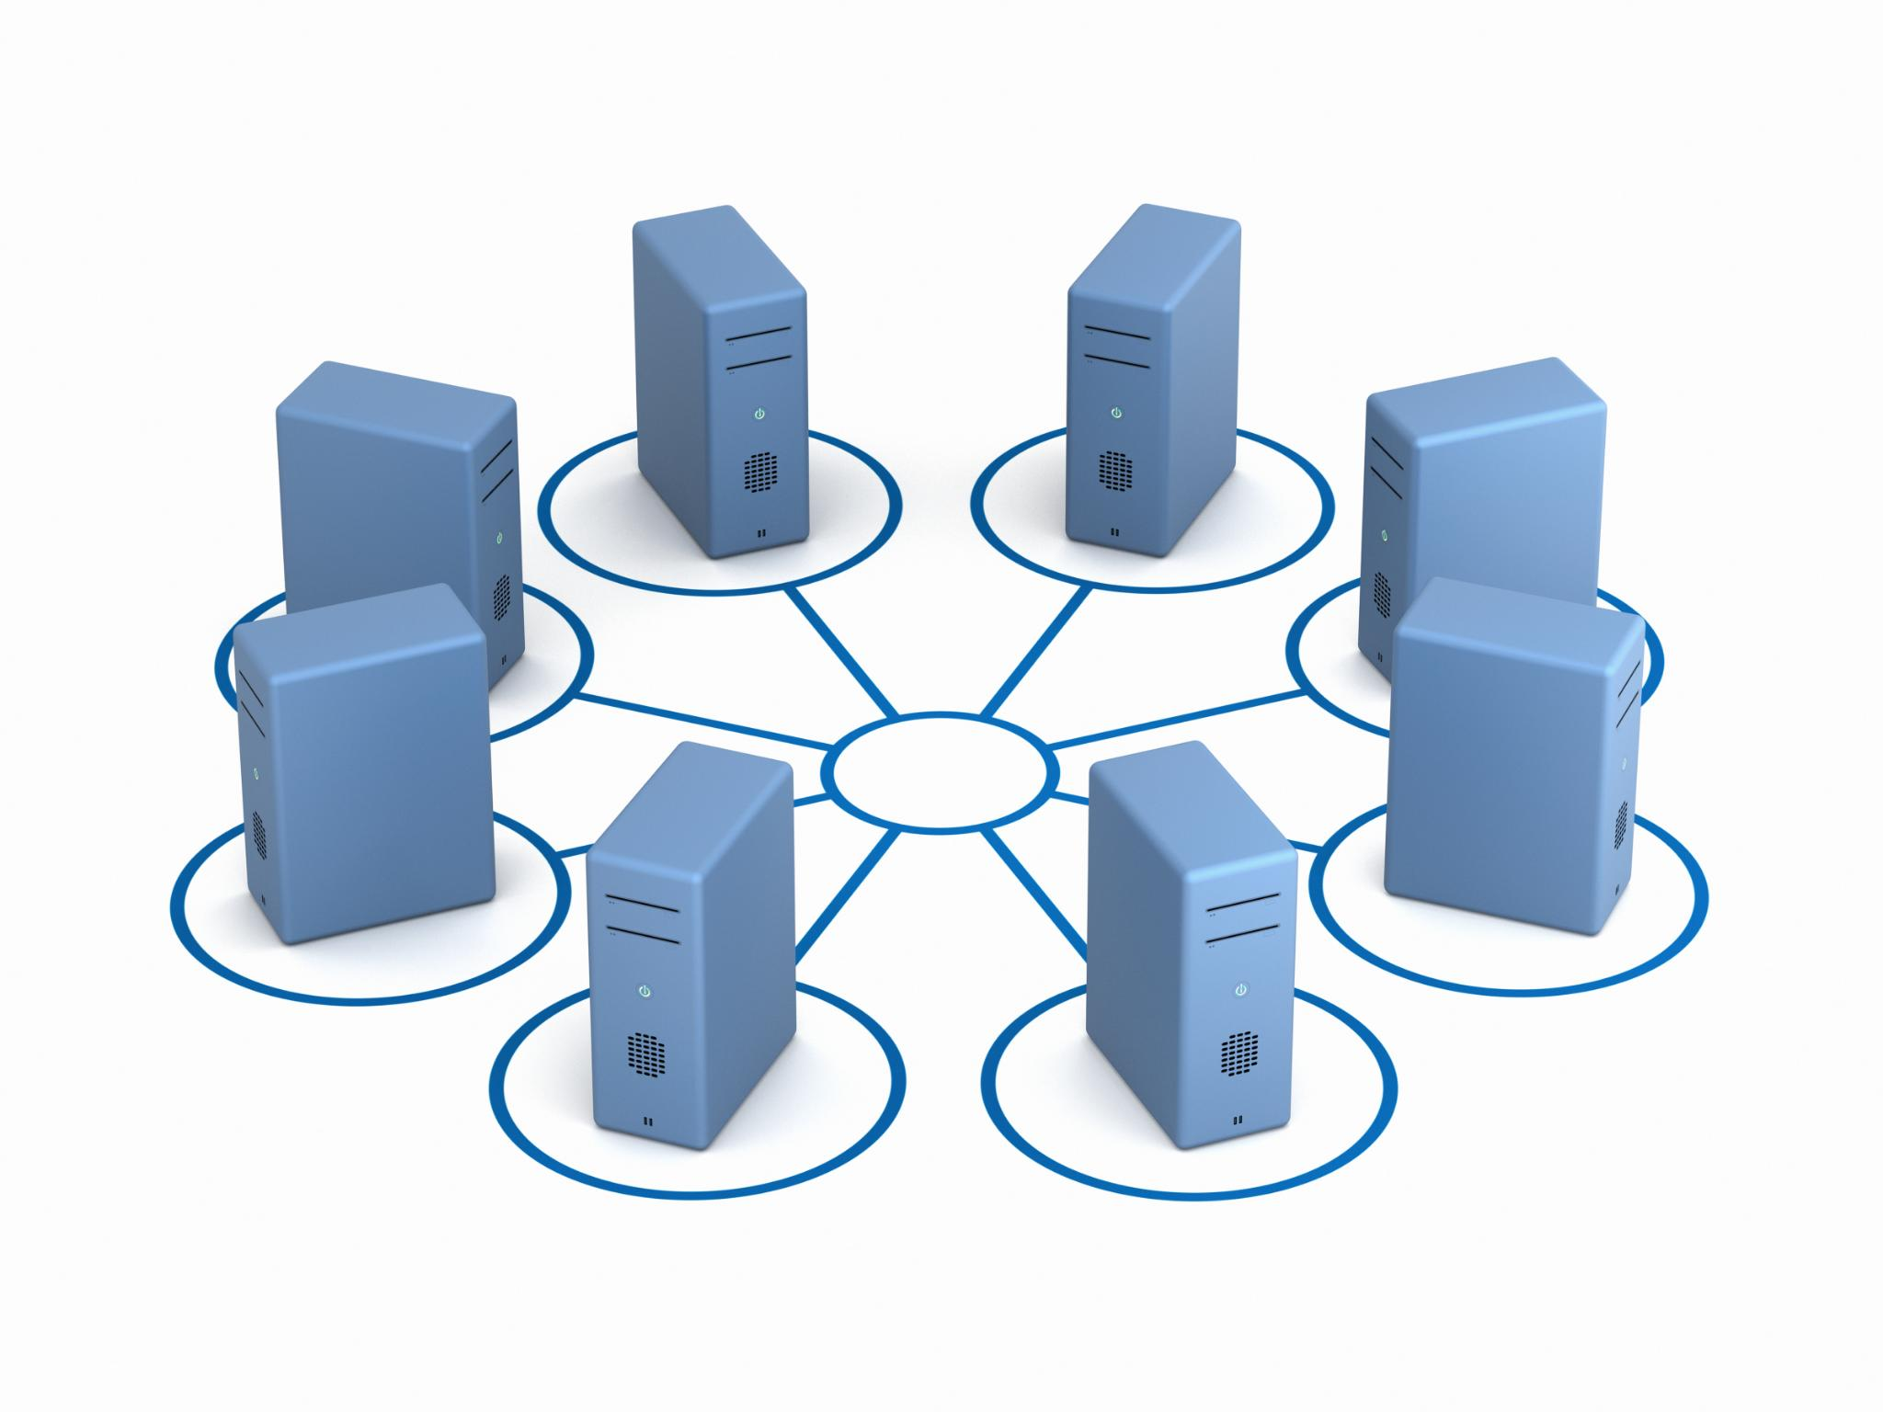
Microservices + Containers
Independent Microservices
Each microservice runs in its own container, enabling isolated and independent deployment and operation.
Scalability and Flexibility
Containers allow microservices to scale independently and use diverse technology stacks for each service.
Team Autonomy
Teams can update microservices independently without affecting other services or the entire system.
Notes:
This slide explains the relationship between microservices and containers. Each microservice typically runs in its own container, allowing independent deployment and scaling. This separation enables teams to update services without impacting others and provides flexibility in choosing different technology stacks for different services.

Slide 17
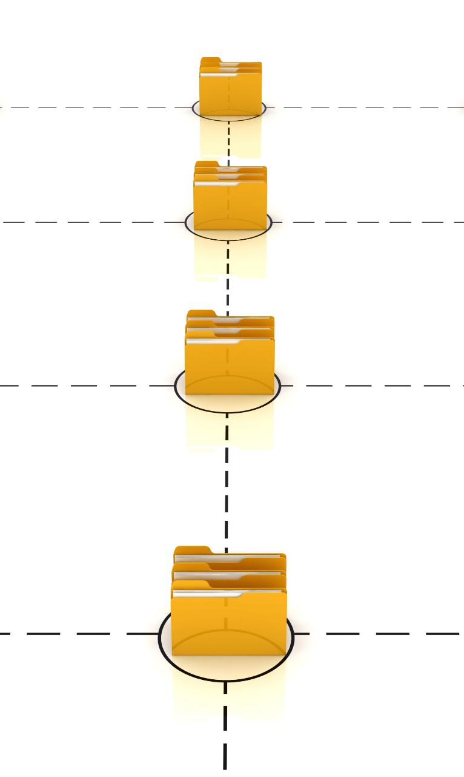
Container Registries
Centralized Image Storage
Container registries act as centralized repositories to store and manage container images efficiently.
Versioning with Image Tags
Registries support version control by using image tags, facilitating easy tracking and retrieval of images.
Facilitating Collaboration
Container registries enable teams and automated systems to share and retrieve images seamlessly for development workflows.
Role in CI/CD Pipelines
Registries are integral to CI/CD pipelines, streamlining deployment by providing reliable access to container images.
Notes:
This slide introduces container registries as centralized storage systems for container images. Registries support versioning through image tags and make it easy for teams and automated systems to share and retrieve images. Registries play a crucial role in CI/CD pipelines and deployment workflows.

Slide 18
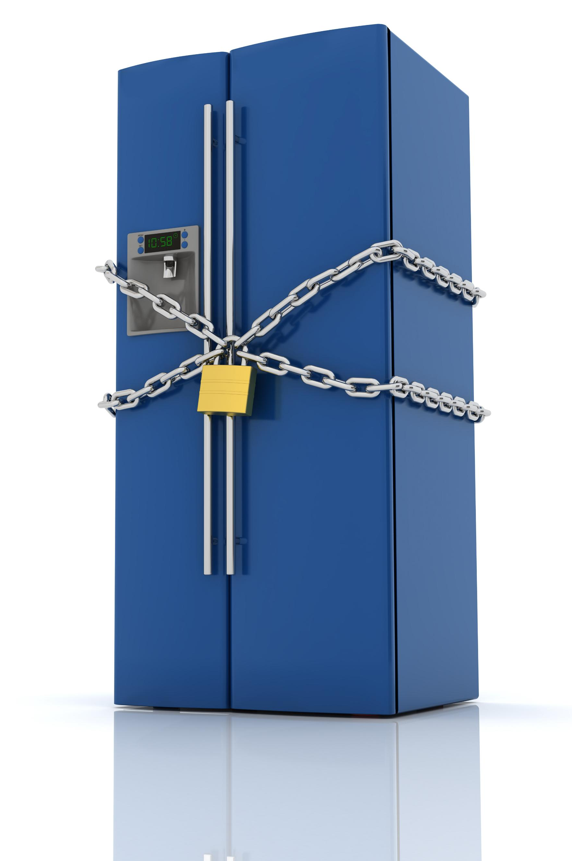
Public vs Private Registries
Public Registries
Public registries offer open access to container images, enabling easy sharing and collaboration across users.
Private Registries
Private registries limit image access to internal teams, providing controlled environments for sensitive data.
Security Considerations
Protecting sensitive images and credentials is critical to maintain enterprise security in container registries.
Notes:
This slide compares public and private container registries. Public registries, such as Docker Hub, provide open access to images, while private registries restrict access for internal use. Security considerations are emphasized, particularly the need to protect sensitive images and credentials in enterprise environments.

Slide 19
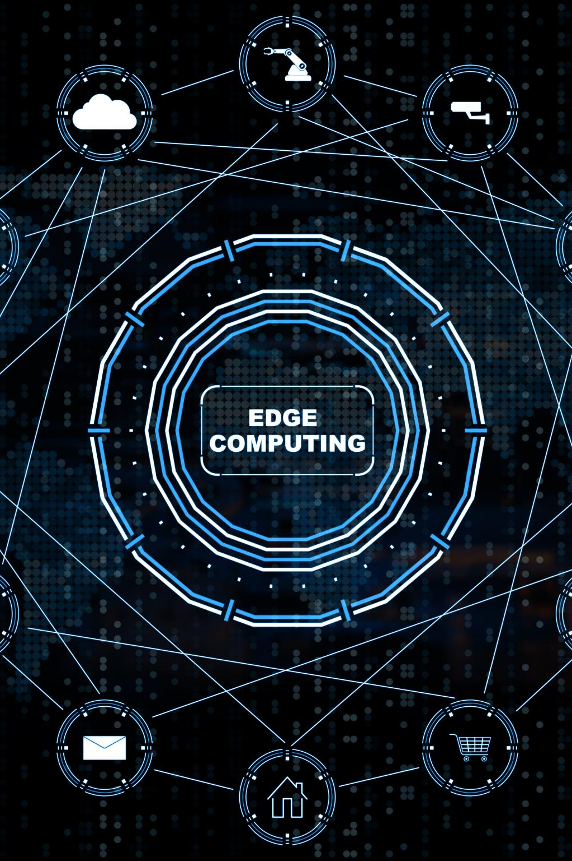
CI/CD and Containers
Continuous Integration with Containers
Continuous Integration automatically builds container images, ensuring consistent and reliable application packaging.
Continuous Deployment Processes
Continuous Deployment deploys containers to target environments quickly and reliably, enabling faster releases.
Benefits of Automation
Automation reduces manual work and human error, improving efficiency and reliability in software delivery.
Notes:
This slide explains how containers fit into CI/CD pipelines. Continuous Integration systems automatically build container images, while Continuous Deployment processes deploy those containers to target environments. Automation is highlighted as a major benefit, reducing manual effort and lowering the risk of human error.

Slide 20
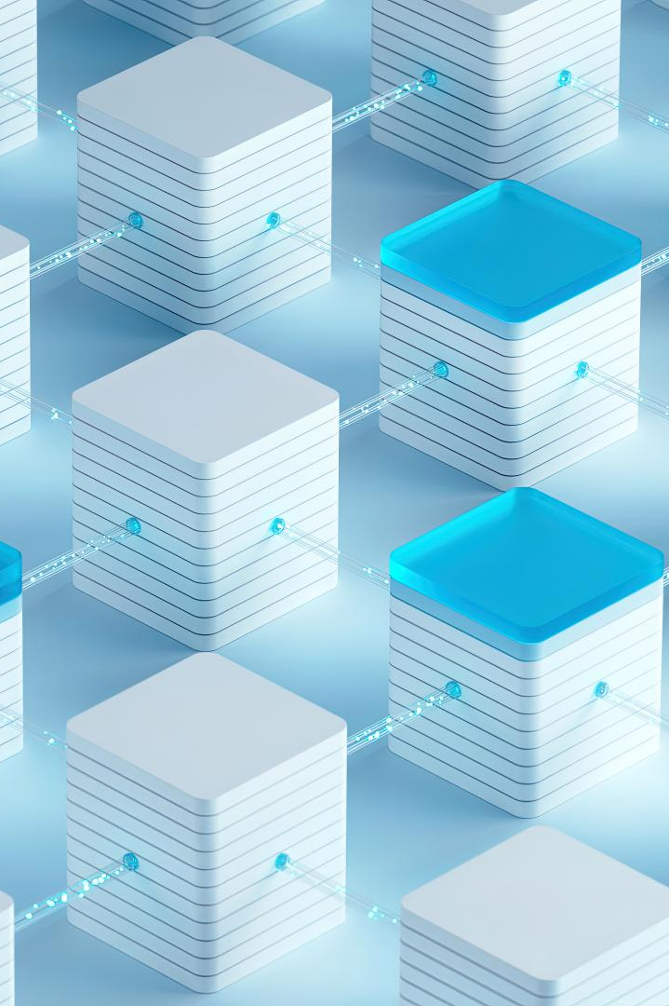
Container Orchestration
Definition of Container Orchestration
Container orchestration manages multiple containers across various hosts efficiently and reliably.
Key Orchestration Tasks
Scheduling, scaling, and failure recovery are essential tasks performed by orchestration platforms.
Kubernetes Platform
Kubernetes is the industry-standard platform widely used for container orchestration.
Notes:
This slide introduces container orchestration as the process of managing many containers across multiple hosts. Orchestration platforms handle tasks such as scheduling, scaling, and failure recovery. Kubernetes is mentioned as the industry-standard tool for container orchestration.

Slide 21

Why Orchestration Is Needed
Automatic Scaling
Orchestration automates scaling to handle varying workloads efficiently across containers.
Self-Healing Containers
Orchestration restarts failed containers to maintain application availability and reliability.
Load Balancing
Orchestration balances traffic across multiple container instances for optimal performance.
Notes:
This slide explains why orchestration is necessary in large-scale container environments. It enables automatic scaling, self-healing by restarting failed containers, and load balancing across multiple instances. These capabilities are essential for reliable and scalable cloud applications.

Slide 22
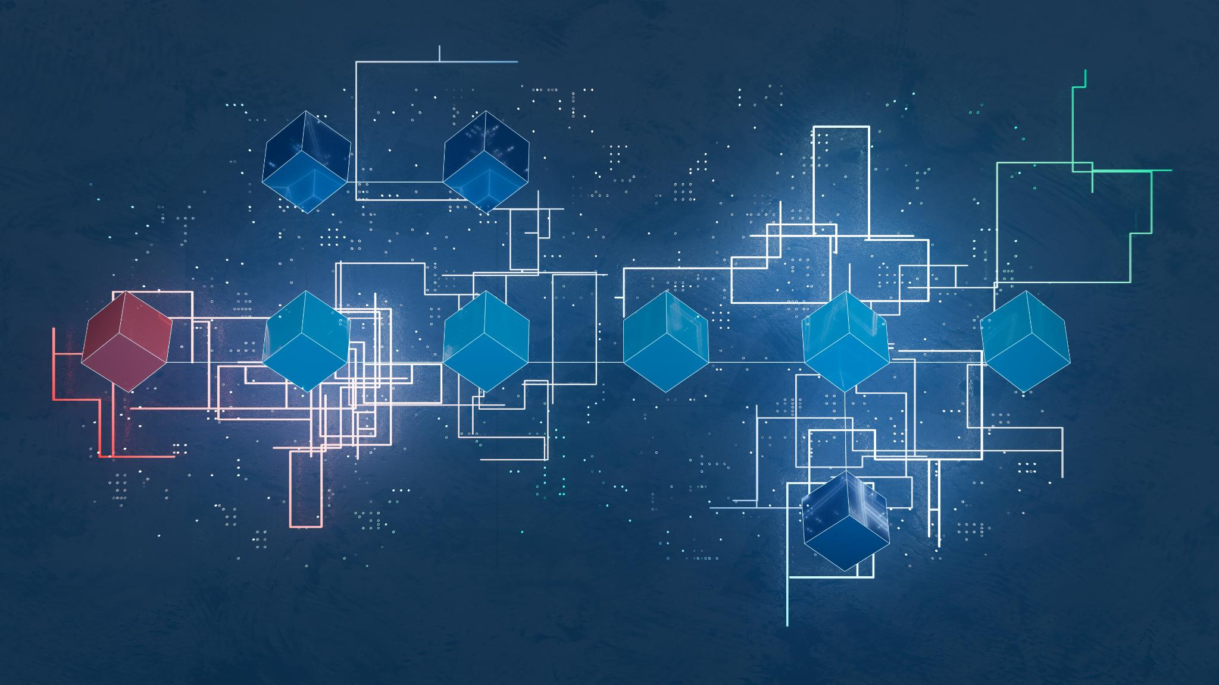
Basic Kubernetes Concepts
Pod as Smallest Unit
Pods are the smallest deployable units in Kubernetes, consisting of one or more containers running together.
Deployments Manage Replicas
Deployments control replica counts and updates to ensure application availability and seamless scaling.
Services Expose Pods
Services provide stable networking to Pods, enabling communication inside and outside the cluster.
Notes:
This slide introduces core Kubernetes concepts. A Pod is described as the smallest deployable unit, containing one or more containers. Deployments manage replica counts and updates, while Services expose Pods to the network. These abstractions simplify managing complex distributed systems.

Slide 23
Containers in Cloud Platforms
Containers as First-Class Citizens
Modern cloud platforms treat containers as essential components for application deployment and management.
Managed Services Simplify Infrastructure
Managed cloud services abstract infrastructure details, easing deployment and operational complexity.
Horizontal Scaling Made Easy
Containers enable easy horizontal scaling, supporting dynamic workloads and efficient resource use.
Notes:
This slide highlights how containers are treated as first-class citizens in modern cloud platforms. Managed services abstract away infrastructure concerns, making deployment and scaling easier. Containers enable straightforward horizontal scaling in the cloud.

Slide 24
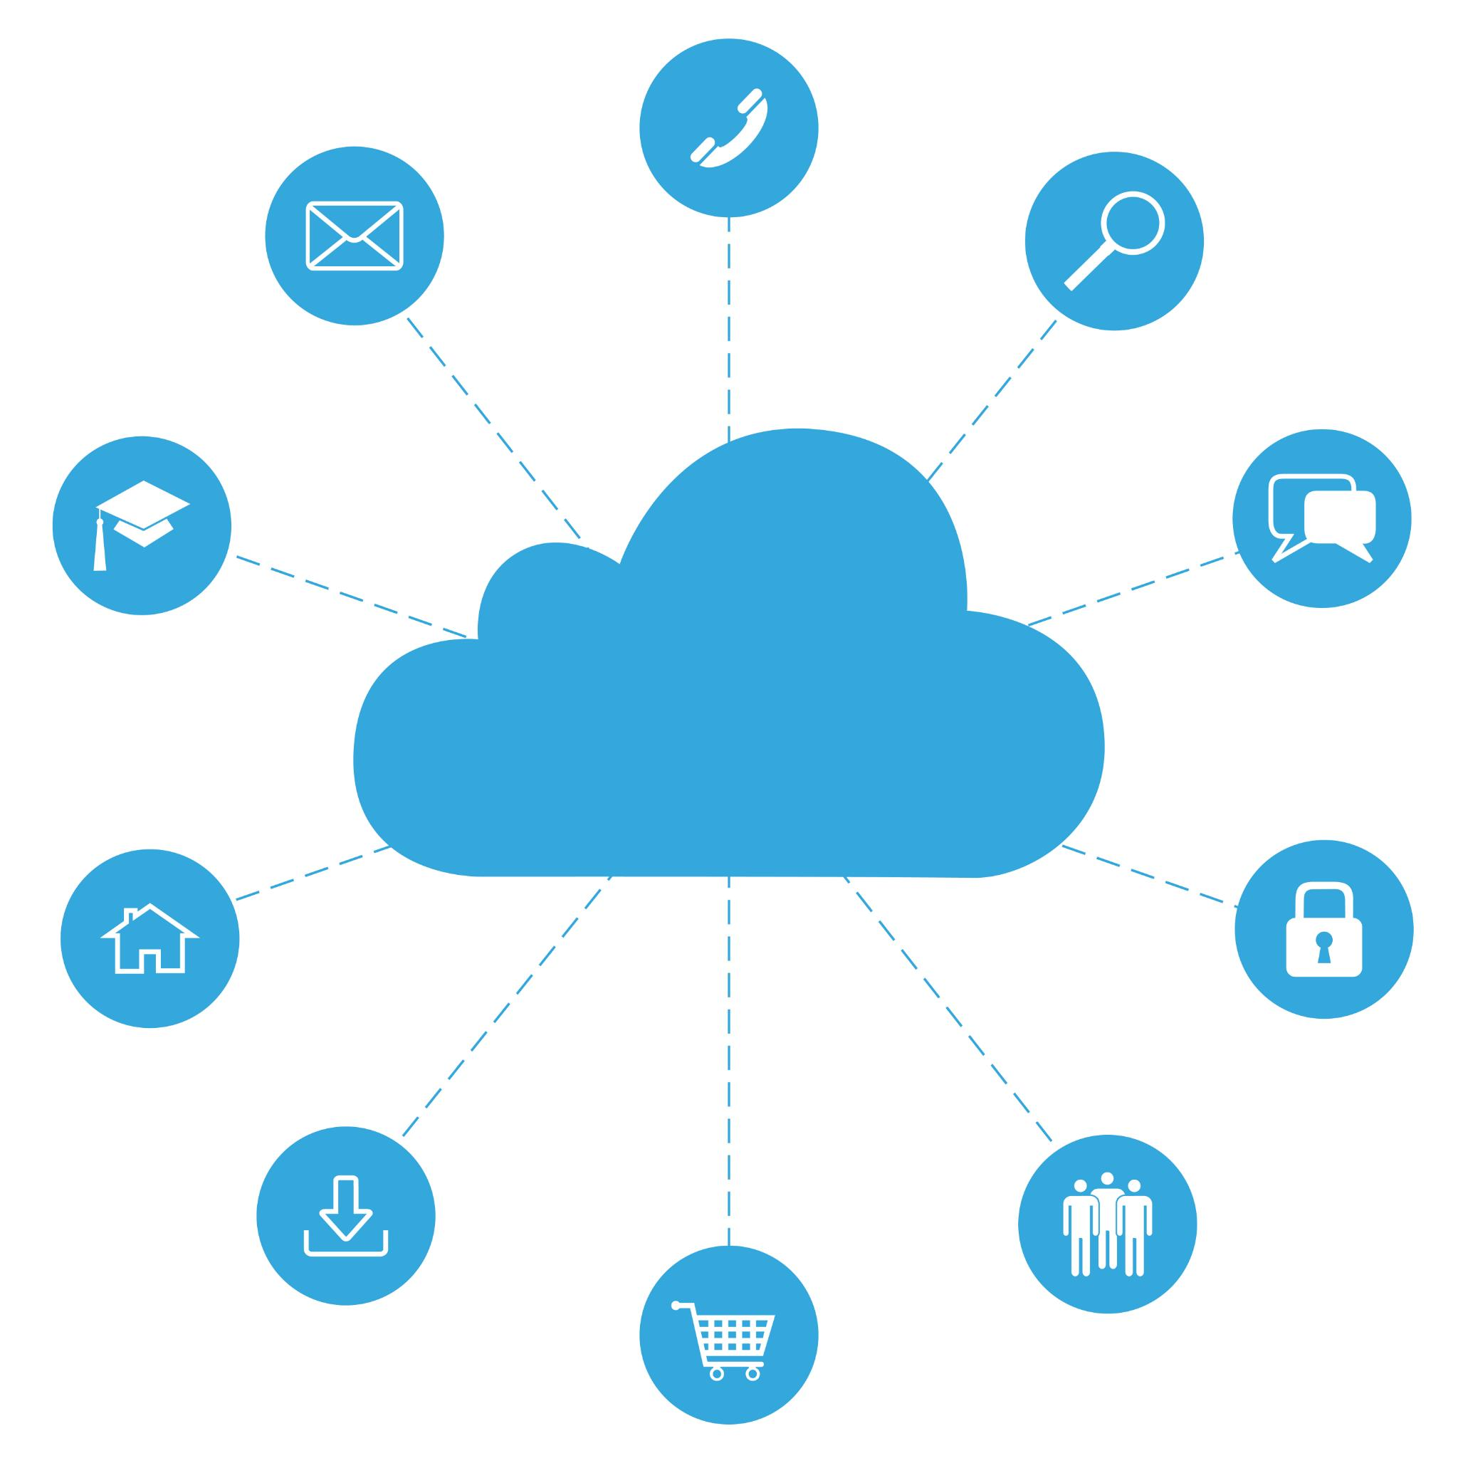
Azure Container Services Overview
Container Instances
Azure Container Instances offer simple and fast deployment for containerized applications without managing servers.
App Service for Containers
App Service supports container-based web apps with managed hosting and scaling capabilities.
Azure Kubernetes Service
Azure Kubernetes Service provides advanced container orchestration for complex, scalable applications.
Notes:
This slide provides an overview of Azure’s container services, including Container Instances, App Service for containers, and Azure Kubernetes Service. Each option supports different levels of abstraction and use cases, from simple workloads to complex orchestration needs.

Slide 25
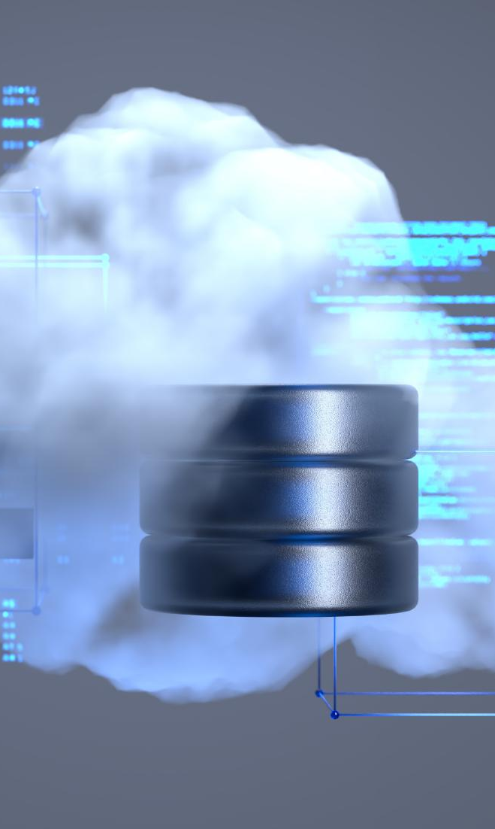
Azure Container Instances
Serverless Container Management
Azure Container Instances eliminate infrastructure management, providing a hassle-free container experience.
Fast Startup Times
ACI offers rapid container startup, enabling quick deployment of workloads without delays.
Usage-Based Billing
Billing is based on actual container usage, making it cost-effective for variable workload demands.
Ideal for Short Workloads
ACI is suitable for simple or short-lived workloads due to its serverless and efficient nature.
Notes:
This slide describes Azure Container Instances as a serverless approach to running containers. There is no need to manage infrastructure, startup times are fast, and billing is based on actual usage. This makes ACI suitable for simple or short-lived workloads.

Slide 26

Azure App Service for Containers
Containerized Web Support
Azure App Service supports containerized web applications for streamlined deployment and management.
Built-in Scaling and Load Balancing
The platform offers automatic scaling and load balancing to handle varying web traffic efficiently.
CI/CD Integration
Integration with continuous integration and continuous deployment streamlines application updates and release cycles.
Notes:
This slide explains how Azure App Service supports containerized web applications. It provides Platform-as-a-Service features such as built-in scaling, load balancing, and CI/CD integration, simplifying container deployment for web workloads.

Slide 27
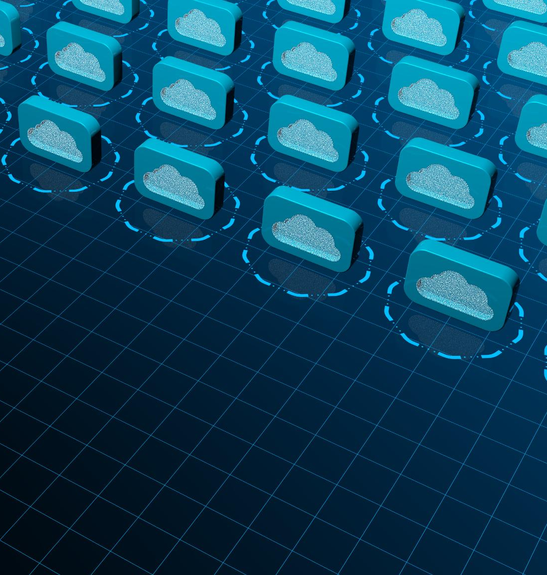
Azure Kubernetes Service (AKS)
Managed Kubernetes Service
AKS is a managed Kubernetes service that handles cluster management and simplifies deployment processes.
Focus on Application Deployment
With AKS managing infrastructure, development teams can focus on deploying and scaling applications efficiently.
Enterprise Microservices Support
AKS supports large-scale, production-ready microservice architectures widely used in enterprise environments.
Notes:
This slide describes AKS as a managed Kubernetes offering. Azure handles cluster management tasks, allowing teams to focus on application deployment. AKS supports large-scale, production-ready microservice systems and is widely used in enterprise environments.

Slide 28
Deployment Strategies
Recreate Deployment
Recreate deployment replaces the old application version entirely with the new one in a single step.
Rolling Updates
Rolling updates gradually replace instances to reduce downtime and ensure continuous service availability.
Blue-Green Deployment
Blue-green deployments switch traffic between two environments to minimize risk during releases.
Notes:
This slide introduces common deployment strategies. Recreate strategies replace the old version entirely. Rolling updates gradually replace instances to reduce downtime. Blue-green deployments switch traffic between two environments, minimizing risk during releases.

Slide 29

Environment Configuration
Environment Variables Injection
Environment variables allow dynamic injection of configuration into containerized applications without code changes.
Secrets Management
Secrets management ensures that sensitive data such as passwords and keys are securely handled in container environments.
Configuration Separation
Keeping configuration separate from code supports deployment across multiple environments with ease and flexibility.
Notes:
This slide focuses on configuration management in containerized systems. Environment variables are used to inject configuration, secrets management ensures secure handling of sensitive data, and configuration is kept separate from code to support multiple environments.

Slide 30

Security Basics
Vulnerability Scanning
Containers should be scanned regularly to detect vulnerabilities from outdated packages and components.
Least Privilege Principle
Containers must be configured with the minimum privileges necessary to reduce security risks.
Protecting Secrets
Credentials and secrets should never be hardcoded within containers to prevent unauthorized access.
Notes:
This slide outlines basic container security principles. Images may contain vulnerabilities due to outdated packages, so scanning is important. Containers should follow the principle of least privilege, and secrets such as credentials must never be hardcoded.

Slide 31

Observability
Logging Application Behavior
Logging records detailed application events to understand runtime behavior and troubleshoot issues effectively.
Performance Monitoring
Monitoring collects performance metrics to track system health and operational status continuously.
Tracing Request Flows
Tracing follows requests across distributed services to identify latency and bottlenecks in workflows.
Notes:
This slide introduces observability as a key requirement for running containers in production. Logging captures application behavior, monitoring tracks performance metrics, and tracing follows request flows across services. Together, these practices enable effective debugging and system insight.

Slide 32
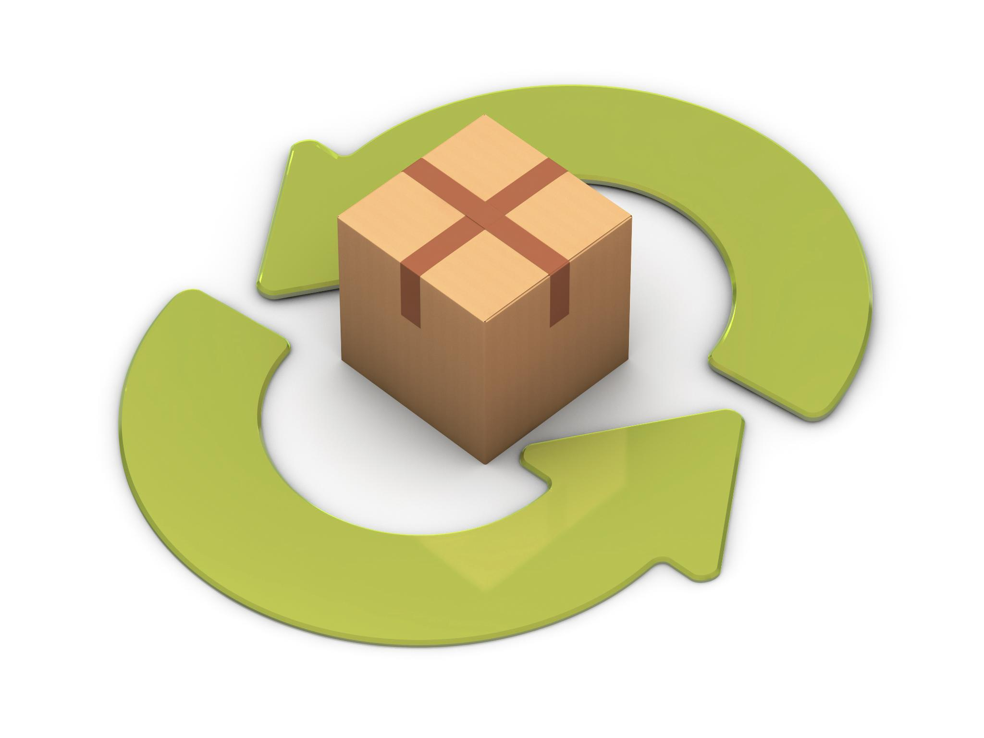
Summary
Container Technology
Containers package applications and dependencies into portable, isolated units for consistent deployment.
Docker as Standard Tool
Docker is the leading platform for building, running, and managing containers efficiently and reliably.
Cloud Platforms and Scaling
Cloud platforms like Azure enable running containers at scale for flexible and robust application deployment.
Foundation for Modern DevOps
Containerization underpins cloud applications, microservices architecture, and modern DevOps workflows.
Notes:
This concluding slide summarizes the lecture. Containers are presented as portable units of software that package applications with their dependencies. Docker is highlighted as the standard tool for building and running containers. Cloud platforms, particularly Azure, provide multiple ways to run containers at scale. Overall, containerization is positioned as a foundational technology for modern cloud applications, microservices, and DevOps practices.

