Slide 1
DevOps & CI/CD Fundamentals
Core principles for streamlined software development processes
Notes:
---

Slide 2
DevOps and Continuous Delivery Foundations
Notes:
Introduction to DevOps, Benefits of DevOps

Slide 3

Introduction to DevOps
Bridging Development and Operations
  DevOps integrates software development and IT operations to eliminate silos and improve collaboration.
Automation and Continuous Delivery
  Automation, continuous integration, and deployment accelerate software delivery and reliability.
Efficiency and Transparency
  Shared tools and monitoring enable faster feedback and alignment between business and tech teams.
Culture and Mindset
  DevOps fosters a culture focused on collaboration, speed, quality, and reliability in delivery.
Notes:
DevOps is a modern approach to software engineering that aims to bridge the gap between software development teams and IT operations teams. Traditionally, development and operations functioned in separate silos, often resulting in slower releases, miscommunication, and deployment issues. DevOps addresses these challenges by encouraging shared responsibility, tighter collaboration, and automation across the entire application lifecycle. One of the core objectives of DevOps is to shorten the development lifecycle while delivering software continuously and reliably. This is achieved through practices such as automation, infrastructure as code, continuous integration, and continuous deployment. Another critical goal of DevOps is improving efficiency and transparency. Teams use shared tools and pipelines, enabling faster feedback loops and better alignment between business objectives and technical implementation. By integrating monitoring, logging, and feedback mechanisms, DevOps also supports continuous improvement, ensuring that issues are identified and resolved quickly. Overall, DevOps is not just a set of tools, but a culture and mindset that focuses on collaboration, speed, quality, and reliability in software delivery.

Slide 4

Benefits of DevOps
Faster Delivery Cycles
  Automation and continuous integration speed up moving code from development to production, increasing organizational agility.
Improved Reliability and Stability
  Continuous testing and monitoring detect issues early, reducing production failures and enhancing software stability.
Enhanced Team Collaboration
  DevOps breaks down silos, fostering communication and shared ownership between development and operations teams.
Reduced Operational Risk
  Automated pipelines ensure consistency, minimize human errors, and build deployment confidence.
Notes:
The adoption of DevOps practices delivers a wide range of benefits to organizations developing and operating software systems. One of the most significant advantages is faster delivery cycles. Through automation and continuous integration and deployment processes, teams can move code from development to production much faster than traditional models. This agility allows organizations to respond quickly to market demands and customer feedback. Another major benefit is improved reliability and stability of software releases. Continuous testing, automated validation, and proactive monitoring ensure that issues are detected early, reducing the risk of failures in production environments. DevOps also enhances collaboration and communication between teams. By breaking down silos and encouraging shared ownership, development and operations teams work together toward common goals. Additionally, DevOps promotes higher deployment confidence and reduced operational risk. Automated pipelines ensure consistency and repeatability, minimizing human errors. Over time, these practices lead to better software quality, improved customer satisfaction, and increased operational efficiency.

Slide 5
CI/CD Concepts and Pipelines
Notes:
What Is CI/CD?, CI/CD Pipeline Overview

Slide 6
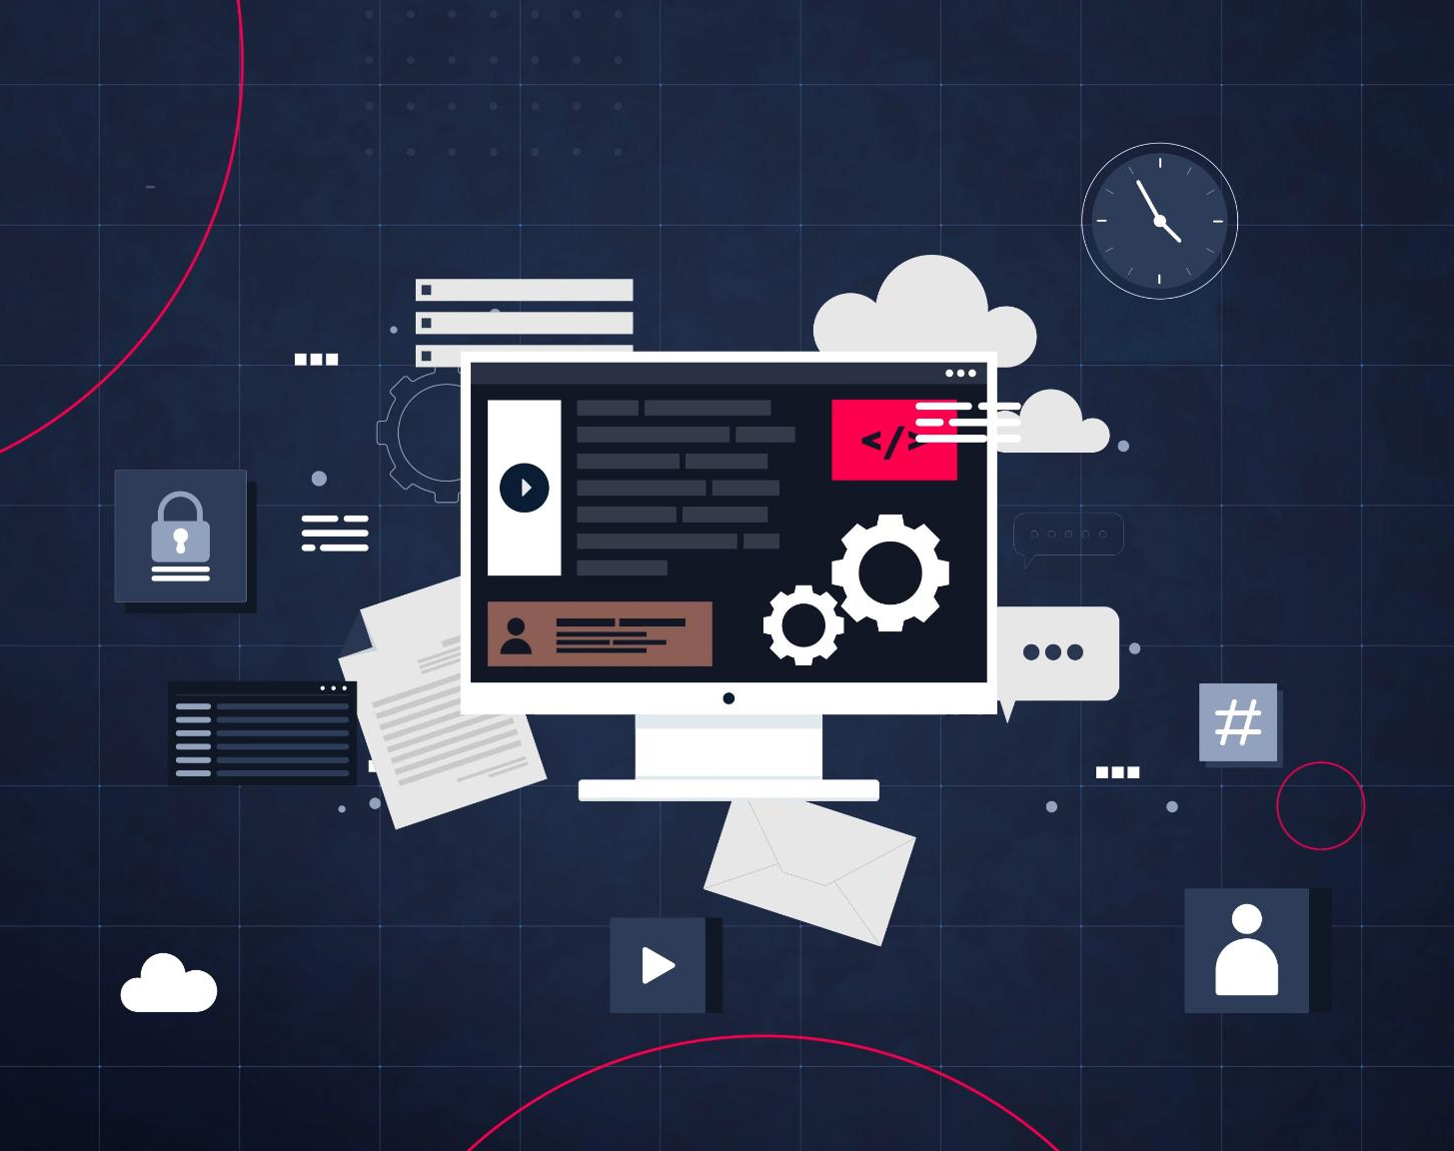
What Is CI/CD?
Continuous Integration (CI)
  CI involves frequently merging code into a shared repository with automated builds and tests to catch issues early.
Continuous Delivery (CD)
  CD ensures software is always ready for release through automated pipelines, making deployments predictable and low-risk.
Continuous Deployment
  This practice automatically deploys code to production after passing all validation stages, enabling fast and reliable updates.
Benefits of CI/CD
  CI/CD increases development speed, reduces manual effort, enables rapid iteration, and improves software quality.
Notes:
Continuous Integration and Continuous Delivery or Deployment, commonly referred to as CI/CD, are fundamental practices within modern DevOps environments. Continuous Integration focuses on frequently merging code changes into a shared repository. Each integration triggers automated build and test processes, allowing teams to quickly identify integration issues and code defects. This practice reduces the complexity of merging large changes and improves overall code quality. Continuous Delivery extends this process by ensuring that software is always in a deployable state. Automated pipelines prepare code for release, making deployments predictable and low-risk. In Continuous Deployment, code changes are automatically deployed to production once they pass all validation stages. Together, CI and CD create a streamlined software delivery pipeline that increases development speed, reduces manual effort, and ensures consistent quality. These practices enable rapid iteration, encourage small and incremental changes, and provide faster feedback to development teams.

Slide 7

CI/CD Pipeline Overview
Automated Workflow Stages
  CI/CD pipelines automate building, testing, packaging, and deploying software efficiently and reliably.
Consistency and Reliability
  Pipelines ensure consistent execution of steps, reducing errors and improving deployment reliability.
Scalability and Integration
  Pipelines scale to handle multiple developers and integrate testing, security scans, and monitoring tools.
Visibility and Traceability
  CI/CD pipelines provide clear visibility into code changes and trace their progression through delivery.
Notes:
A CI/CD pipeline is an automated workflow that defines the stages a code change goes through before reaching production. Typical pipeline stages include building the application, running automated tests, packaging artifacts, and deploying to different environments. Pipelines ensure consistency and repeatability by executing the same steps in the same order every time a change is introduced. This reduces human error and increases deployment reliability. Pipelines also support scalability, as they can handle frequent changes from multiple developers simultaneously. By integrating tools for testing, security scanning, and monitoring, pipelines provide comprehensive validation of software quality. In addition, CI/CD pipelines enable visibility and traceability, allowing teams to understand where changes originated and how they progressed through the delivery process. Overall, pipelines form the backbone of modern software delivery in DevOps environments.

Slide 8
Version Control and Collaboration with Git
Notes:
Introduction to Git, Branching, Merging, and Workflow Models

Slide 9
Introduction to Git
Distributed Version Control
Git's distributed architecture allows each developer to have a full repository copy, enabling offline work and reducing server dependency.
Commit History Tracking
Git captures code snapshots through commits, preserving a detailed history of changes for review and rollback.
Collaboration and DevOps Integration
Git supports teamwork and automation by integrating with CI/CD pipelines, enhancing traceability and workflow efficiency.
Notes:
Git is a distributed version control system designed to manage source code changes efficiently. It allows multiple developers to collaborate on the same codebase while maintaining a complete history of modifications. One of Git’s key advantages is its distributed architecture, where each developer has a full copy of the repository. This enables offline work and reduces dependency on a central server. Git tracks changes through commits, which capture snapshots of the code at specific points in time. This history allows teams to review changes, revert to previous versions, and identify when and why modifications were made. Git forms the foundation of modern DevOps workflows, supporting collaboration, traceability, and automation through integration with CI/CD pipelines.

Slide 10
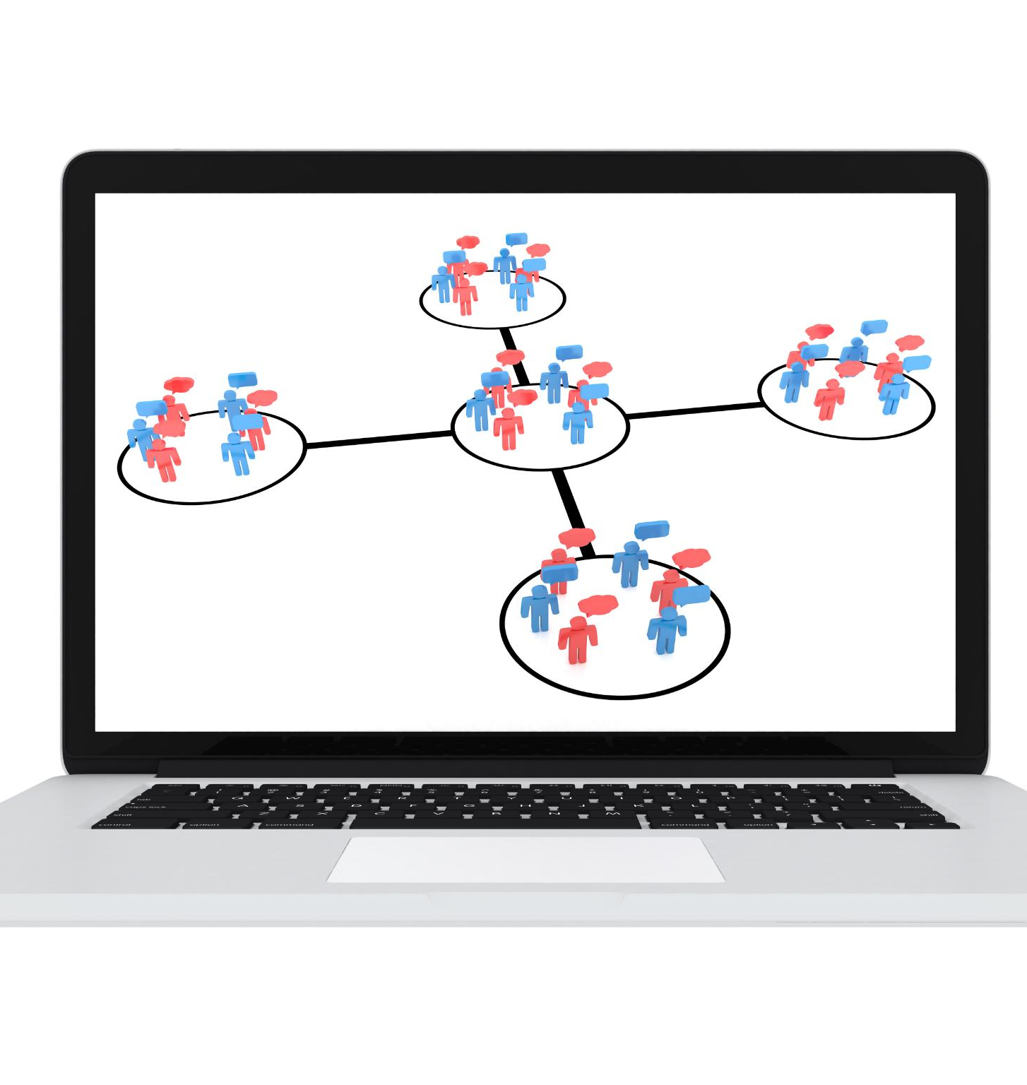
Branching, Merging, and Workflow Models
Branching in Git
  Branching allows isolated development of features and fixes, preventing destabilization of the main codebase.
Pull Requests and Code Reviews
  Pull requests propose code changes and enable reviews, improving code quality and promoting team knowledge sharing.
Git Workflow Models
  Git Flow uses structured branches; trunk-based development encourages frequent commits to a main branch.
Notes:
Branching is a core concept in Git that allows developers to work on features, fixes, or experiments independently of the main codebase. Feature branches isolate work and reduce the risk of destabilizing the main branch. Pull requests are used to propose changes and trigger code reviews before merging. This review process improves code quality and facilitates knowledge sharing across teams. Different Git workflow models exist to support various development styles. Git Flow uses structured branches for features, releases, and hotfixes, while trunk-based development encourages frequent commits to a single main branch. Choosing the appropriate workflow depends on team size, release frequency, and organizational requirements.

Slide 11
Automation with GitHub Actions
Notes:
Introduction to GitHub Actions, GitHub Actions Components and Runners

Slide 12

Introduction to GitHub Actions
CI/CD Automation Platform
  GitHub Actions automates continuous integration and deployment directly within GitHub repositories.
Event-Driven Workflows
  Workflows trigger automatically on events like code pushes, pull requests, or scheduled tasks.
Multi-Platform Support
  Supports many programming languages and platforms, making it versatile for diverse projects.
Seamless GitHub Integration
  Integrated with GitHub for simplified configuration and access control without extra infrastructure.
Notes:
GitHub Actions is a CI/CD automation platform integrated directly into GitHub repositories. It enables developers to automate workflows such as building, testing, and deploying applications based on repository events. Workflows are event-driven and can be triggered by actions such as pushing code, opening pull requests, or scheduled timers. GitHub Actions supports a wide range of programming languages and platforms, making it suitable for many types of projects. Its tight integration with GitHub simplifies configuration and access control, allowing teams to implement automation without additional infrastructure.

Slide 13

GitHub Actions Components and Runners
Workflow Definitions
  Workflows are defined in YAML files specifying jobs and steps for automation tasks.
Jobs and Steps
  Jobs group related tasks while steps are individual actions run sequentially or in parallel.
Hosted vs Self-hosted Runners
  Hosted runners are managed by GitHub; self-hosted runners offer customization and control.
Notes:
GitHub Actions workflows are defined using YAML files that describe jobs and steps. Jobs represent groups of tasks, while steps define individual actions executed sequentially or in parallel. Runners are the execution environments where jobs run. GitHub provides hosted runners managed by the platform, as well as support for self-hosted runners. Hosted runners simplify maintenance, while self-hosted runners offer greater control and customization. Together, these components allow teams to design flexible and powerful automation pipelines.

Slide 14
Infrastructure as Code and Best Practices
Notes:
Infrastructure as Code (IaC), DevOps Best Practices and Summary

Slide 15

Infrastructure as Code (IaC)
IaC Definition
  IaC manages and provisions infrastructure through machine-readable code, replacing manual configurations.
Approaches to IaC
  Declarative approach defines desired end state; imperative approach specifies steps to achieve infrastructure setup.
Version Control Benefits
  Storing infrastructure code in version control ensures traceability, change history, and collaboration.
Role in CI/CD Pipelines
  IaC enables automated provisioning and environment consistency across development, testing, and production stages.
Notes:
Infrastructure as Code is the practice of managing and provisioning infrastructure through machine-readable code rather than manual processes. IaC enables teams to define infrastructure in a consistent and repeatable manner, reducing configuration drift and deployment errors. Declarative approaches describe the desired end state of infrastructure, while imperative approaches define the steps to reach that state. By storing infrastructure definitions in version control systems, teams gain traceability, change history, and collaboration benefits similar to application code. IaC plays a critical role in CI/CD pipelines by enabling automated provisioning and environment consistency across development, testing, and production.

Slide 16

DevOps Best Practices and Summary
Automation Reduces Errors
  Automating repetitive tasks decreases human error and boosts efficiency in software development and deployment.
Continuous Monitoring and Feedback
  Ongoing monitoring and feedback loops help identify and resolve issues early, improving overall processes.
CI/CD and IaC Impact
  Integration of CI/CD pipelines and Infrastructure as Code enables faster, reliable, and scalable software delivery.
Scalability and Resilience
  DevOps best practices enhance scalability, maintainability, and resilience in modern application environments.
Notes:
Effective DevOps adoption relies on a set of best practices that emphasize automation, collaboration, and continuous feedback. Automating repetitive tasks reduces human error and increases efficiency. Continuous monitoring, logging, and feedback loops enable teams to detect issues early and improve processes over time. DevOps, combined with CI/CD and IaC, enables faster, more reliable software delivery. These practices support scalability, maintainability, and resilience in modern application environments, making them essential pillars of contemporary software engineering.

